Slide 1
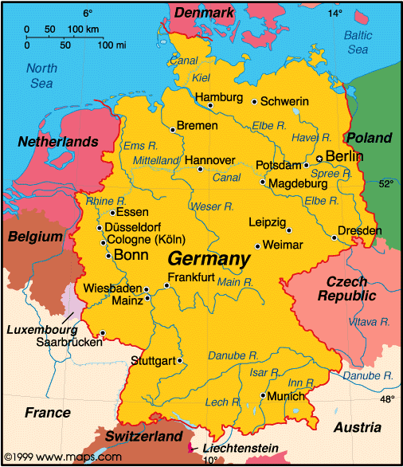
Goethe Institut Transatlantic Outreach Program

Slide 2
What?
Transatlantic Outreach Program founded in 2002 (Goethe Institut founded in 1951)
Promote education about Germany
Provide opportunity to experience Germany

Slide 3
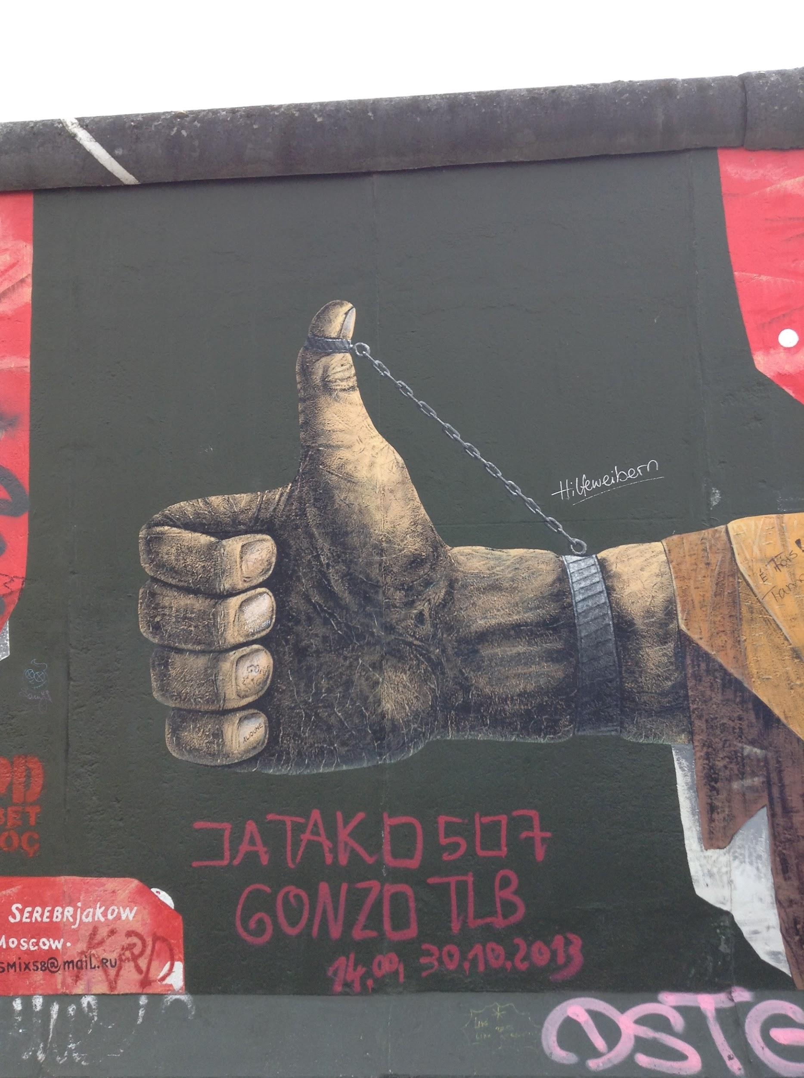
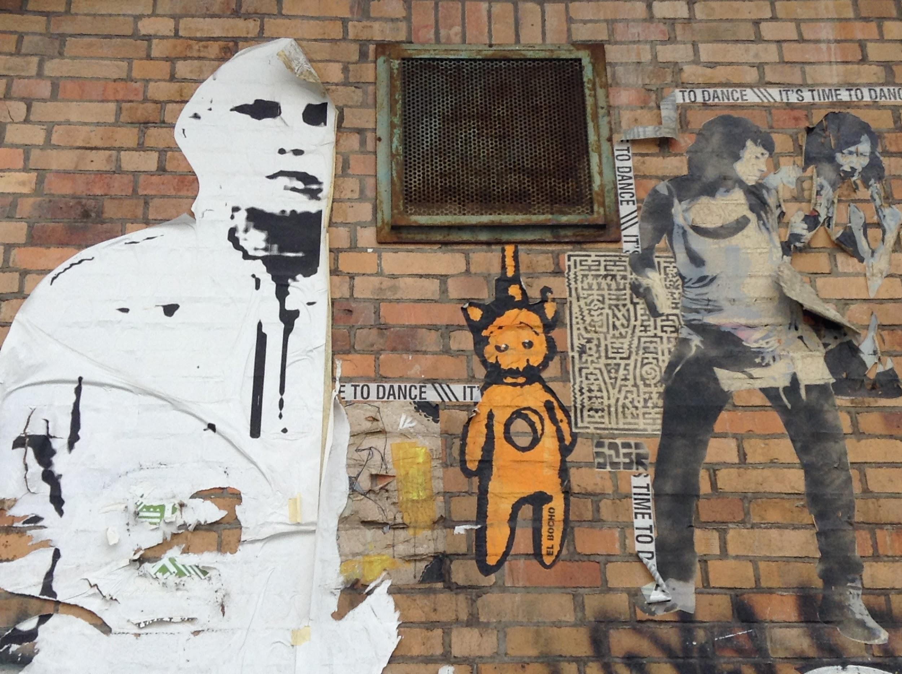
Resources
Teaching Materials and
German Study Tours

Slide 4
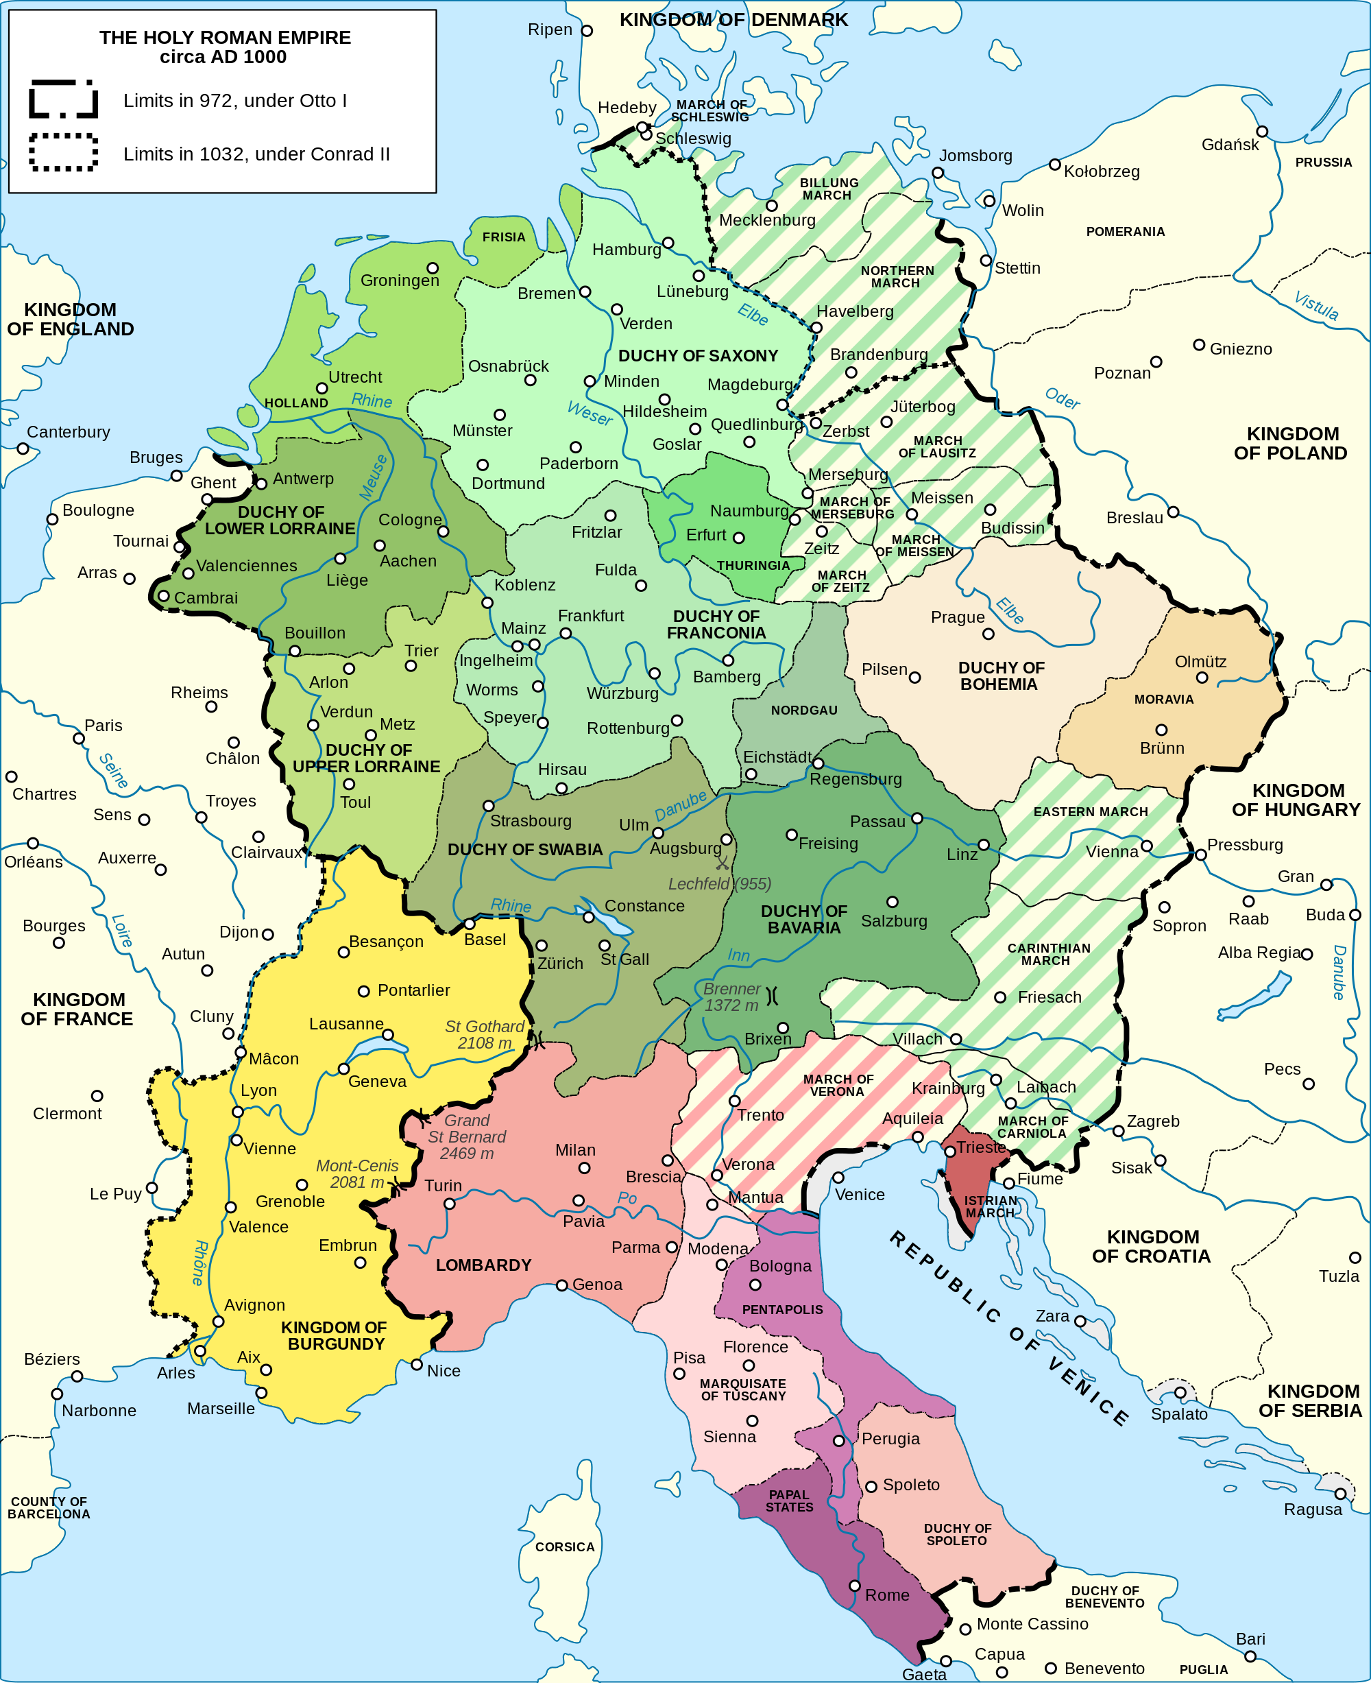
Holy Roman Empire: 962-1806

Slide 5
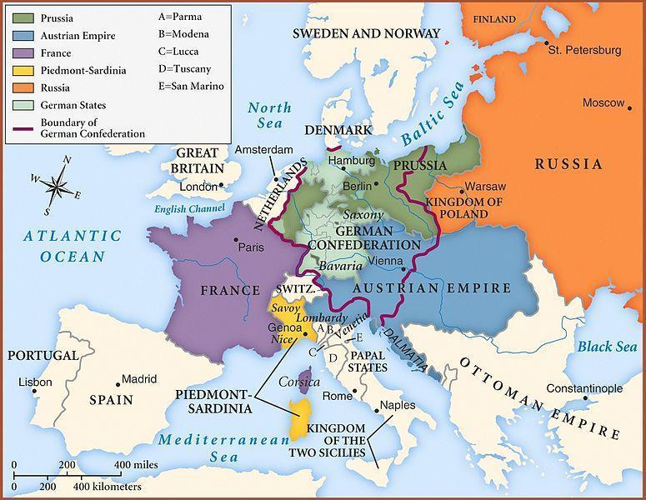
CONGRESS OF VIENNA
1815

Slide 6
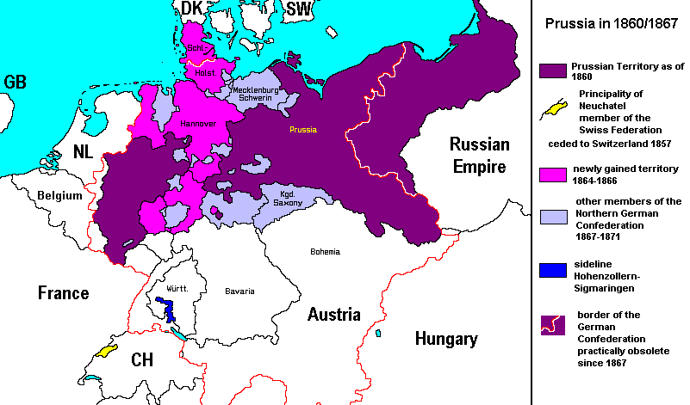

Slide 7
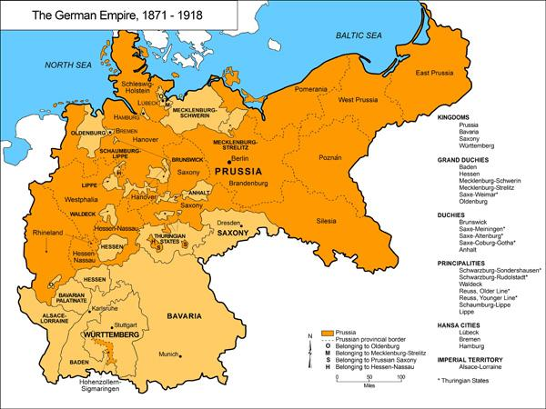

Slide 8
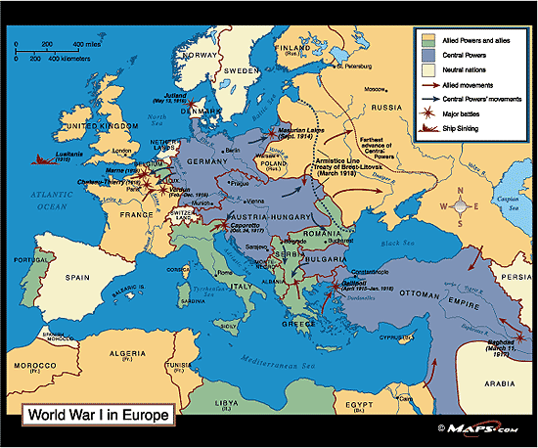
World War I: 1914-1918

Slide 9
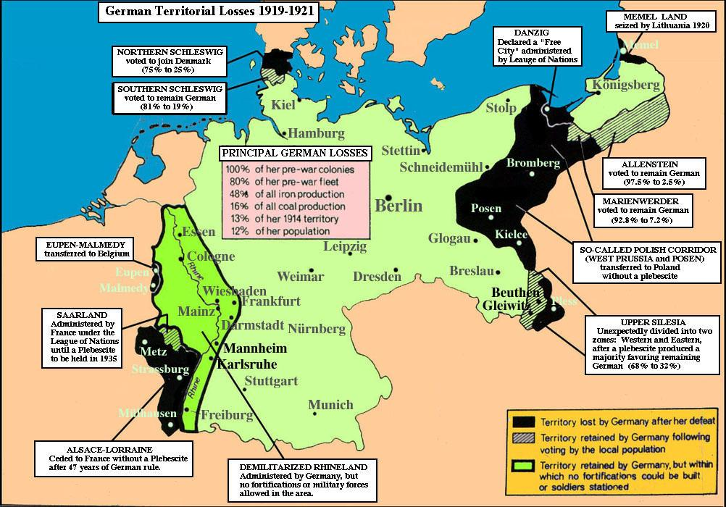
Treaty of Versailles 1919

Slide 10
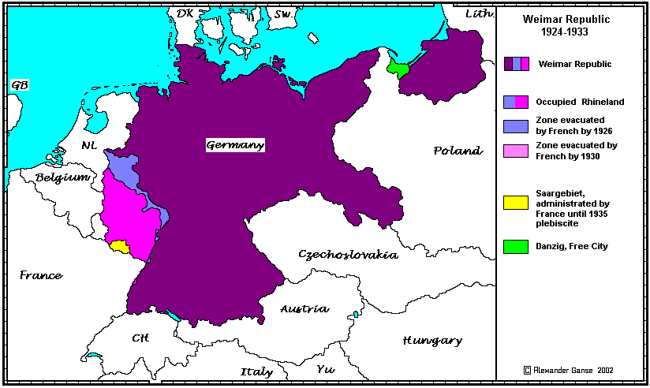

Slide 11
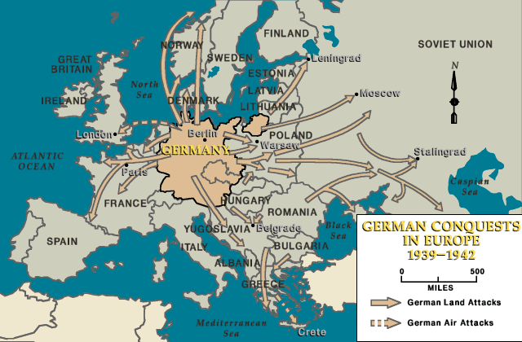

Slide 12
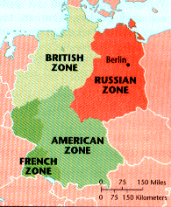
MILITARY OCCUPATION:
1945-1949

Slide 13
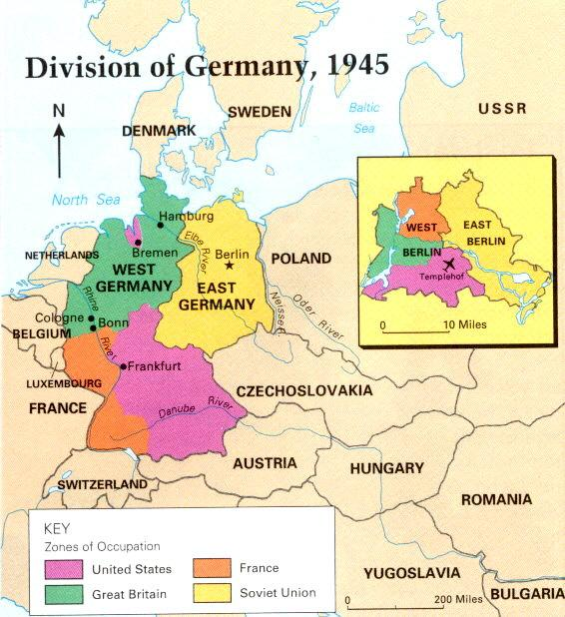

Slide 14
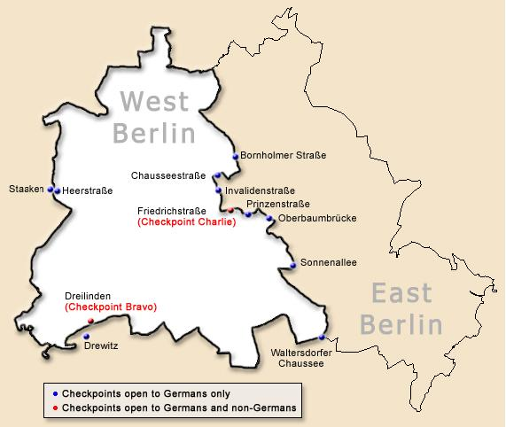
The Berlin
Wall
August 13, 1961-
November 9, 1989

Slide 15
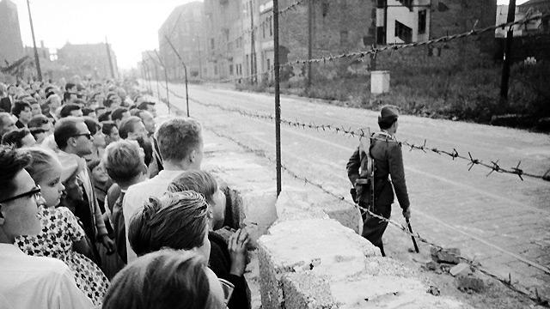
96 miles Statistics

Slide 16
Transatlantic Outreach Program
Munich: Schools, Dachau, Data Protection, Politicians
Geisa: Point Alpha
Leipzig: Dresden, Stasi and the Peaceful Revolution
Berlin: Stasi Museum, Memorials, Potsdam, Immigration, Reichstag

Slide 17
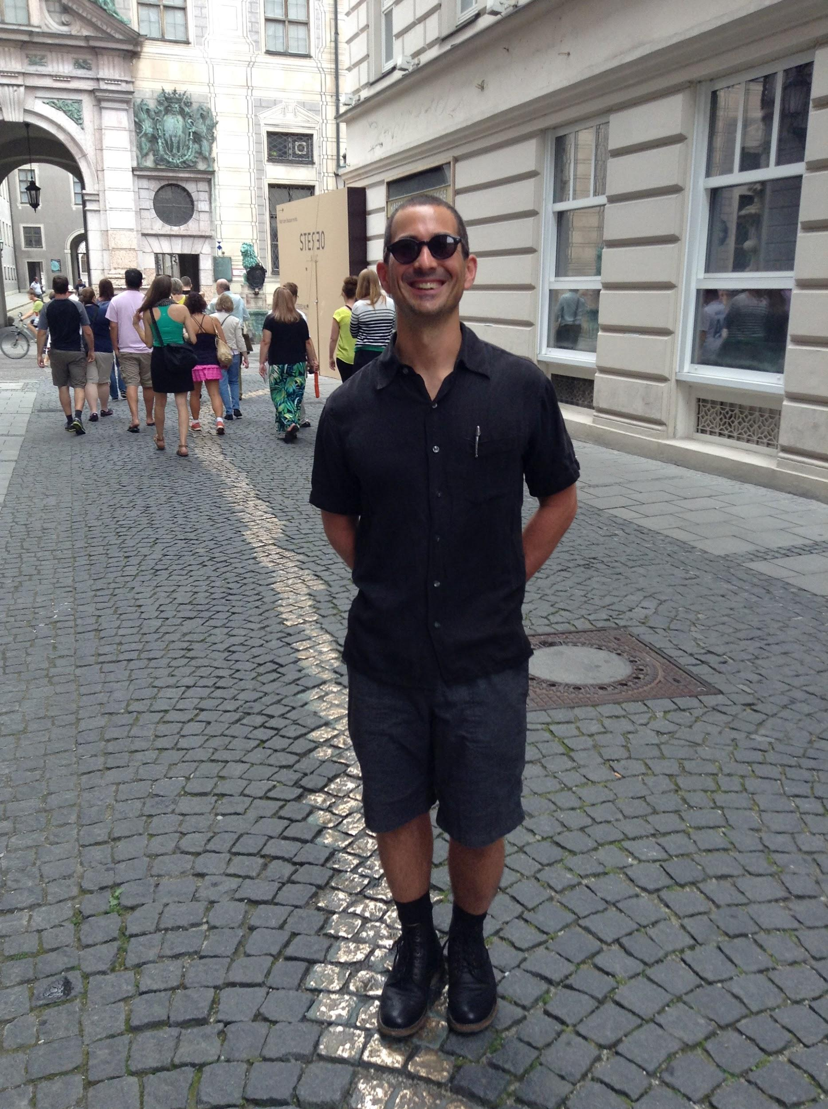
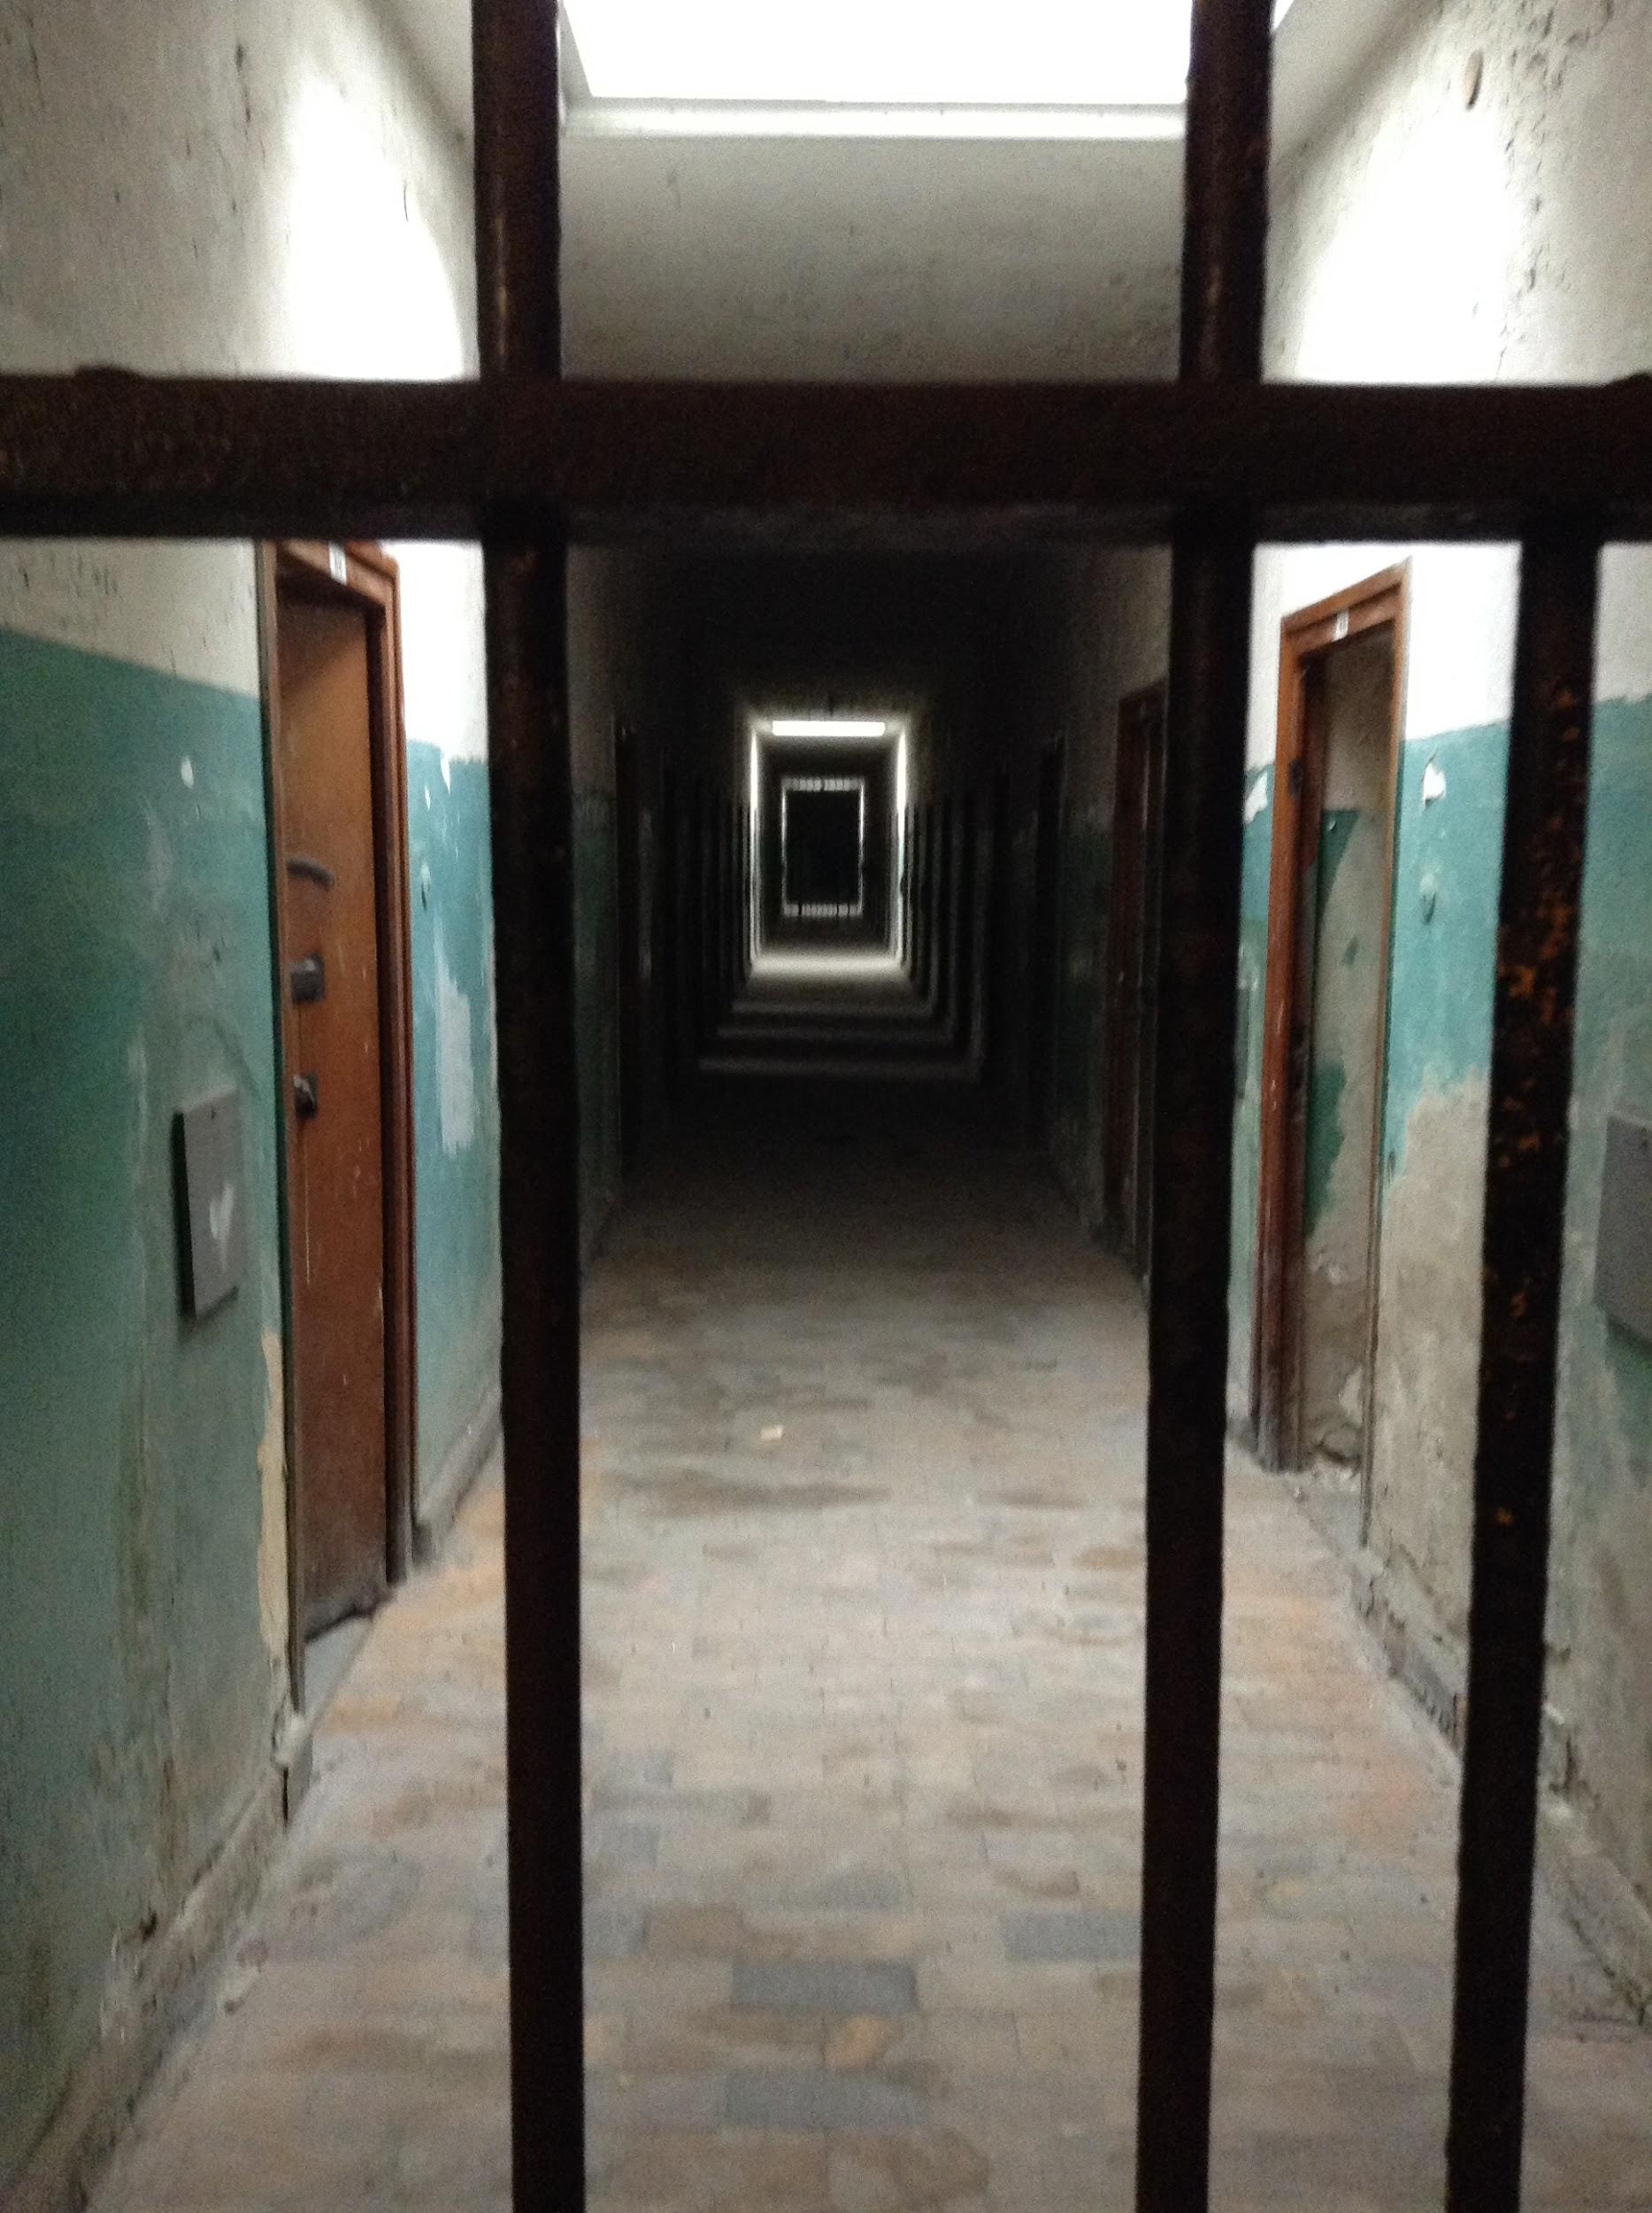
Munich: Bavaria Wealthy and Conservative

Slide 18
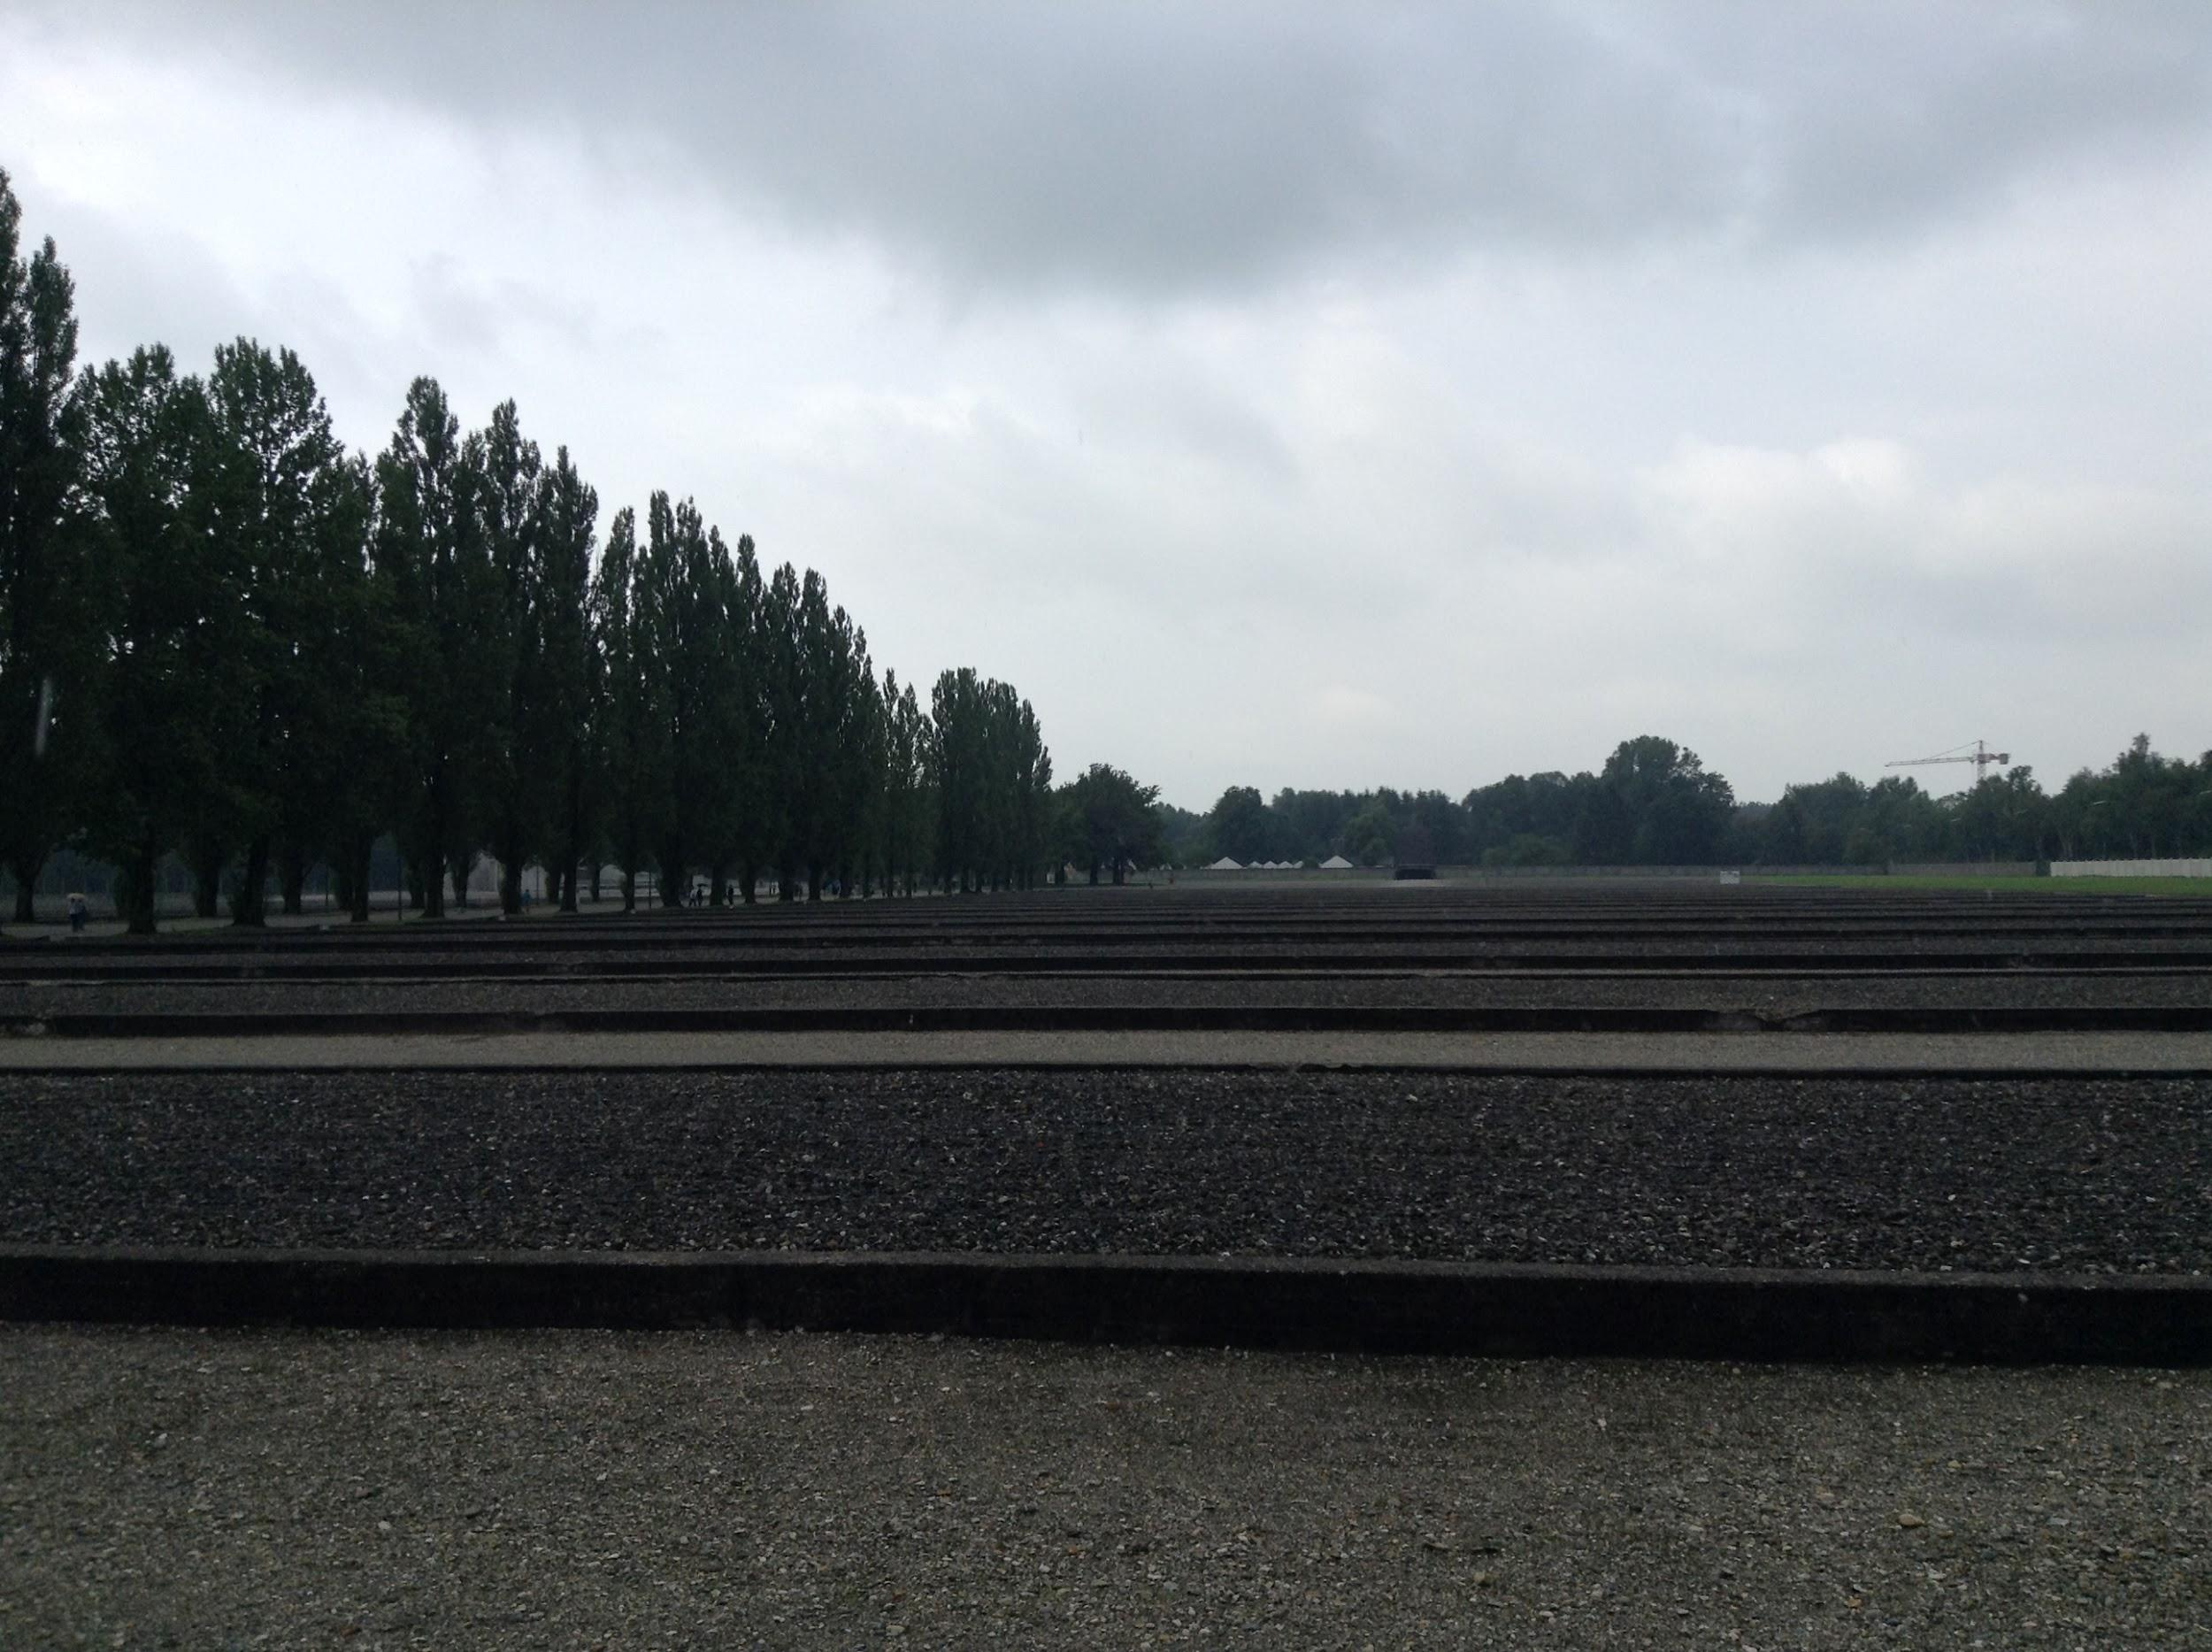
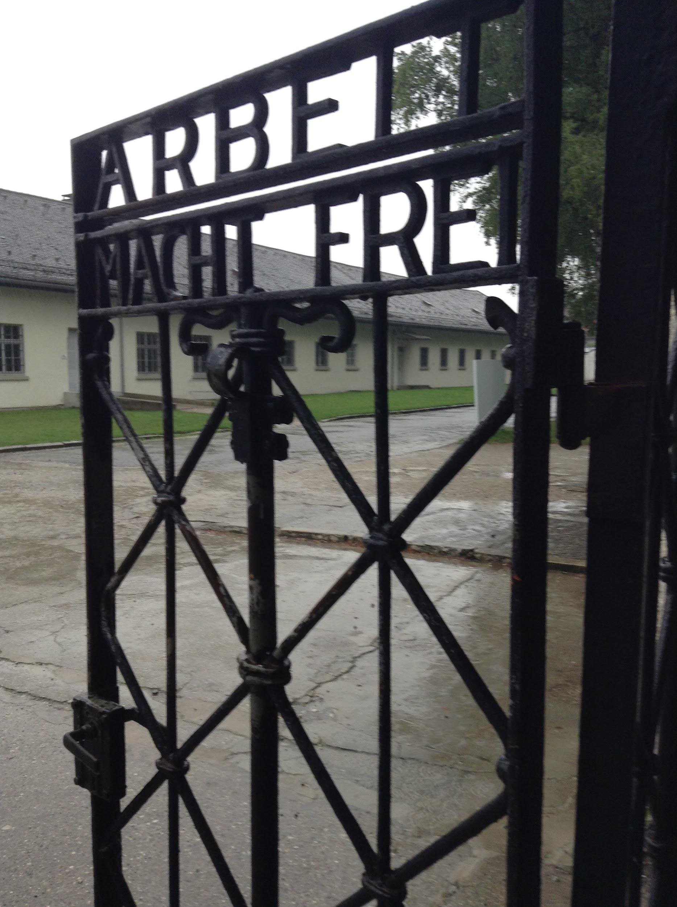
Dachau: The First Concentration Camp

Slide 19
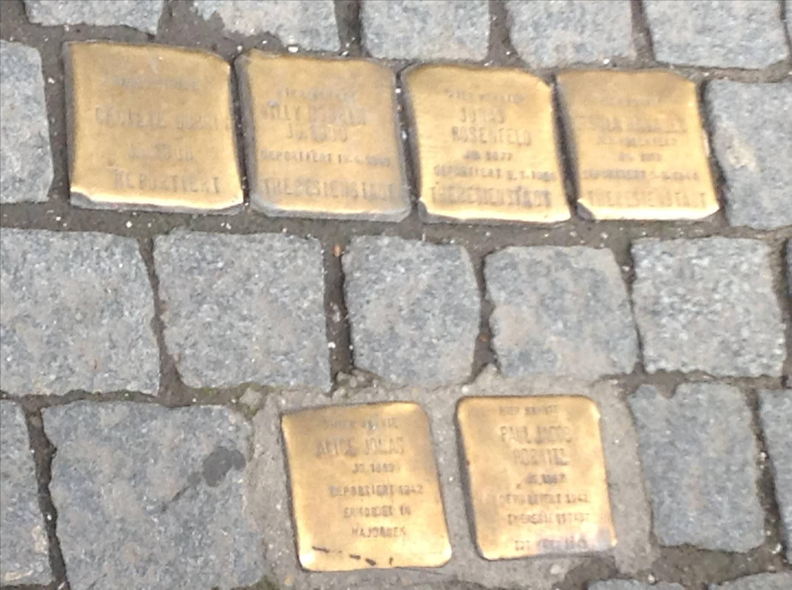

Slide 20
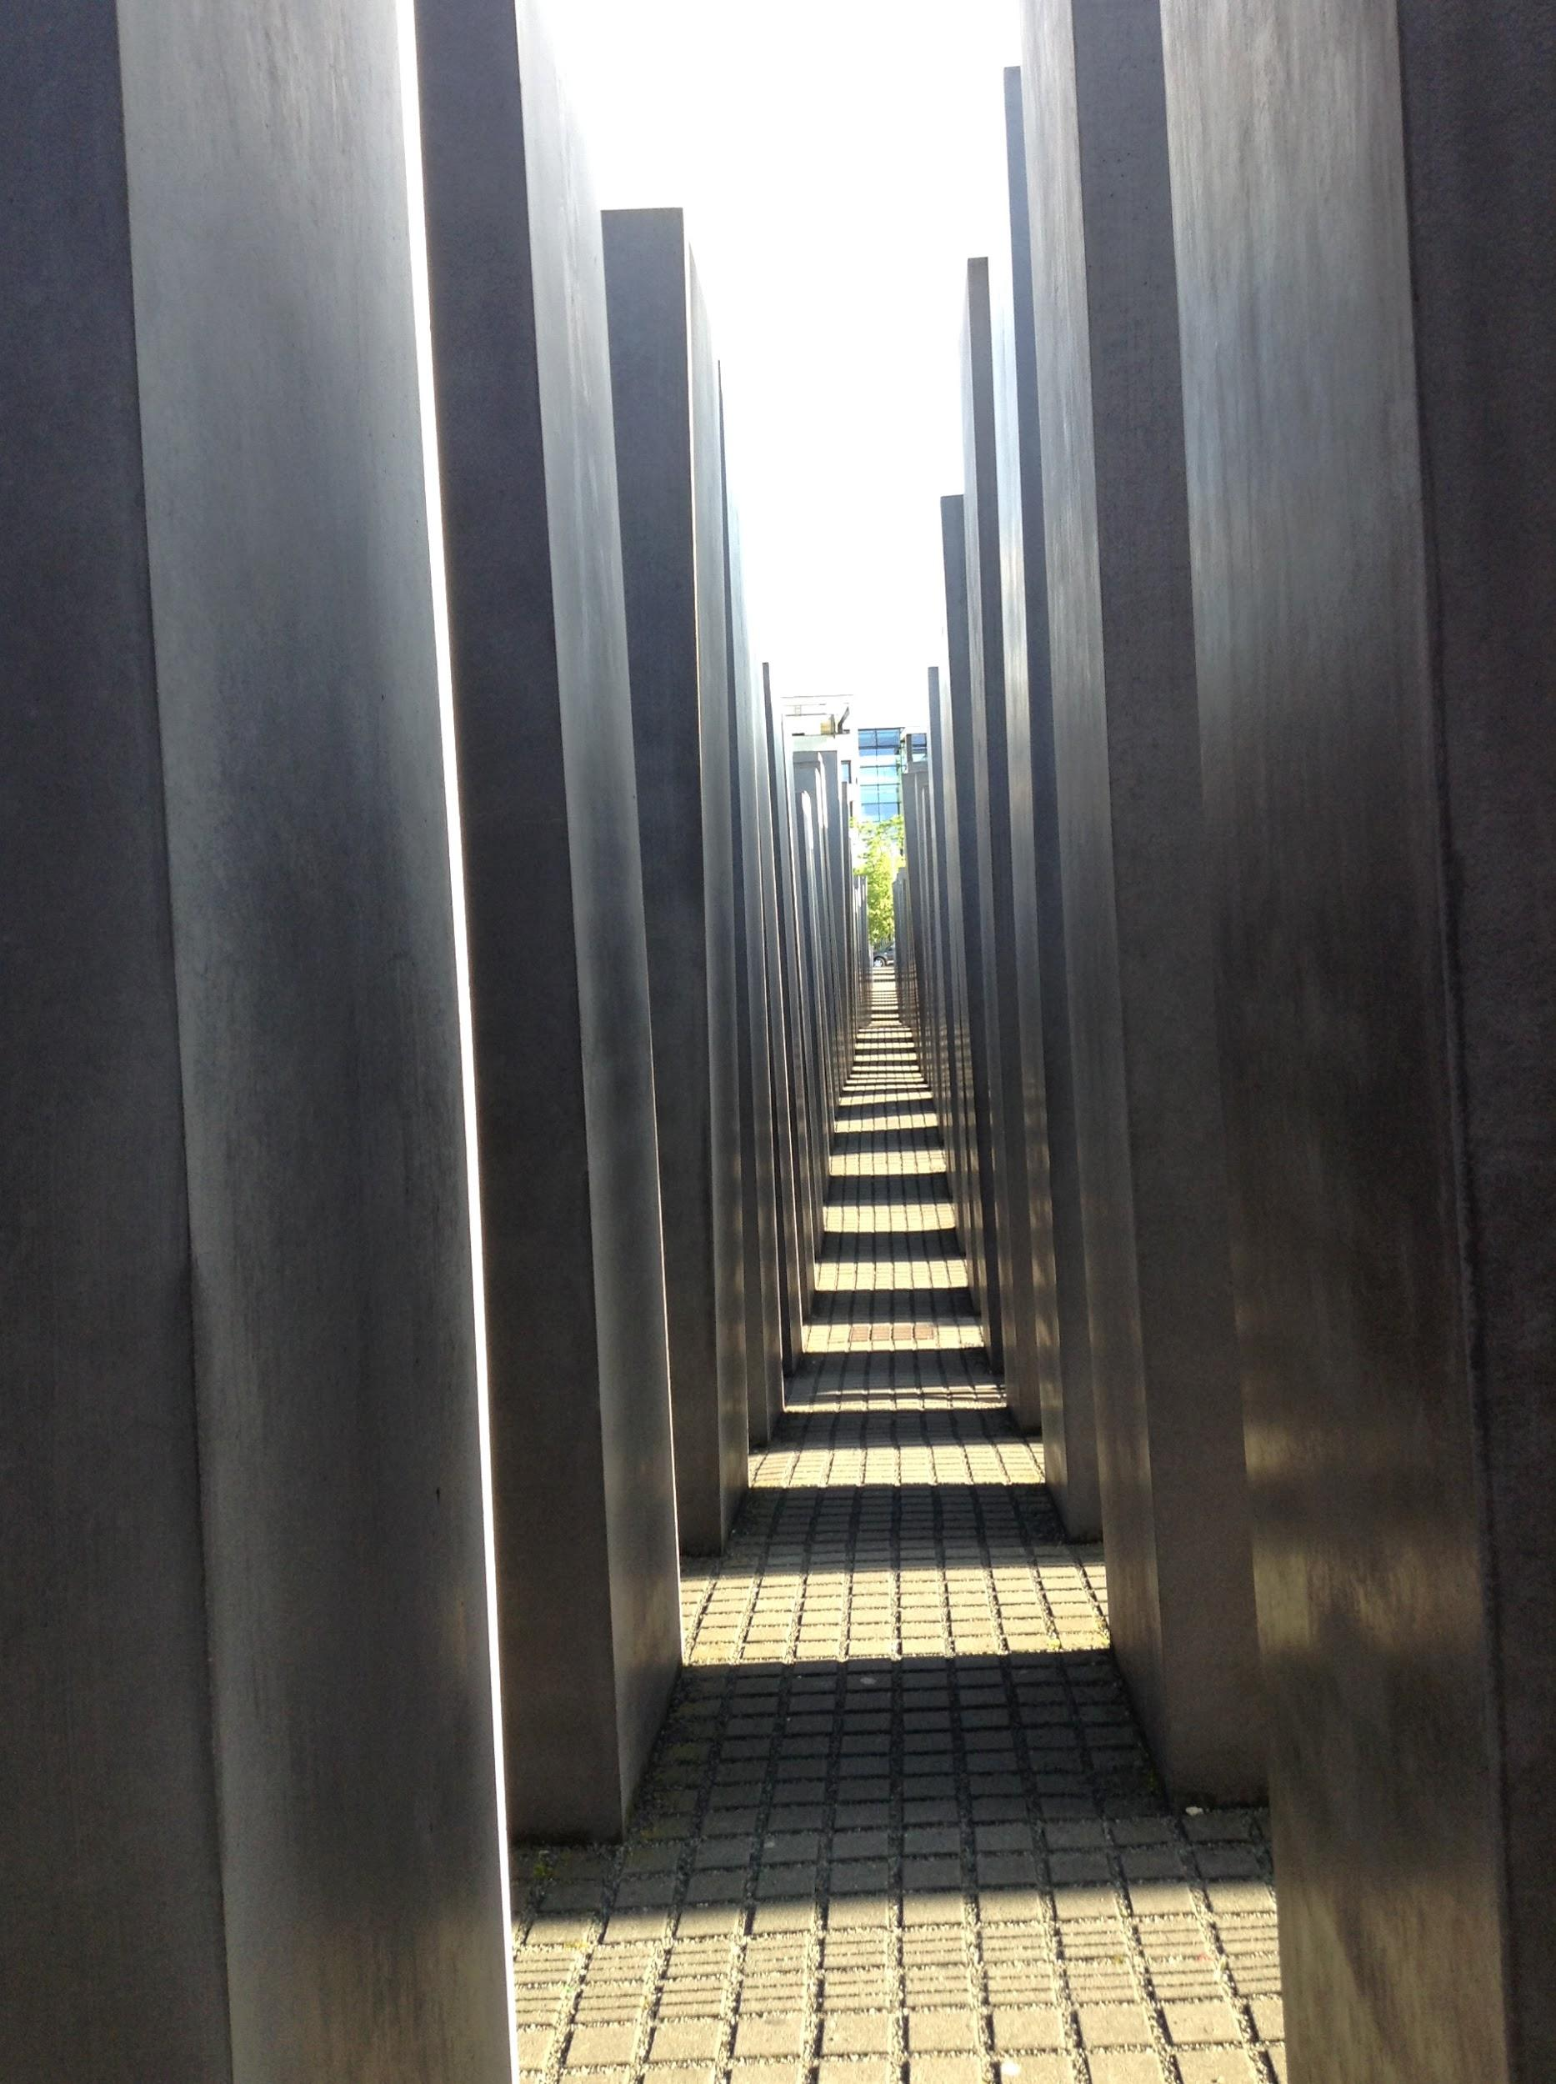
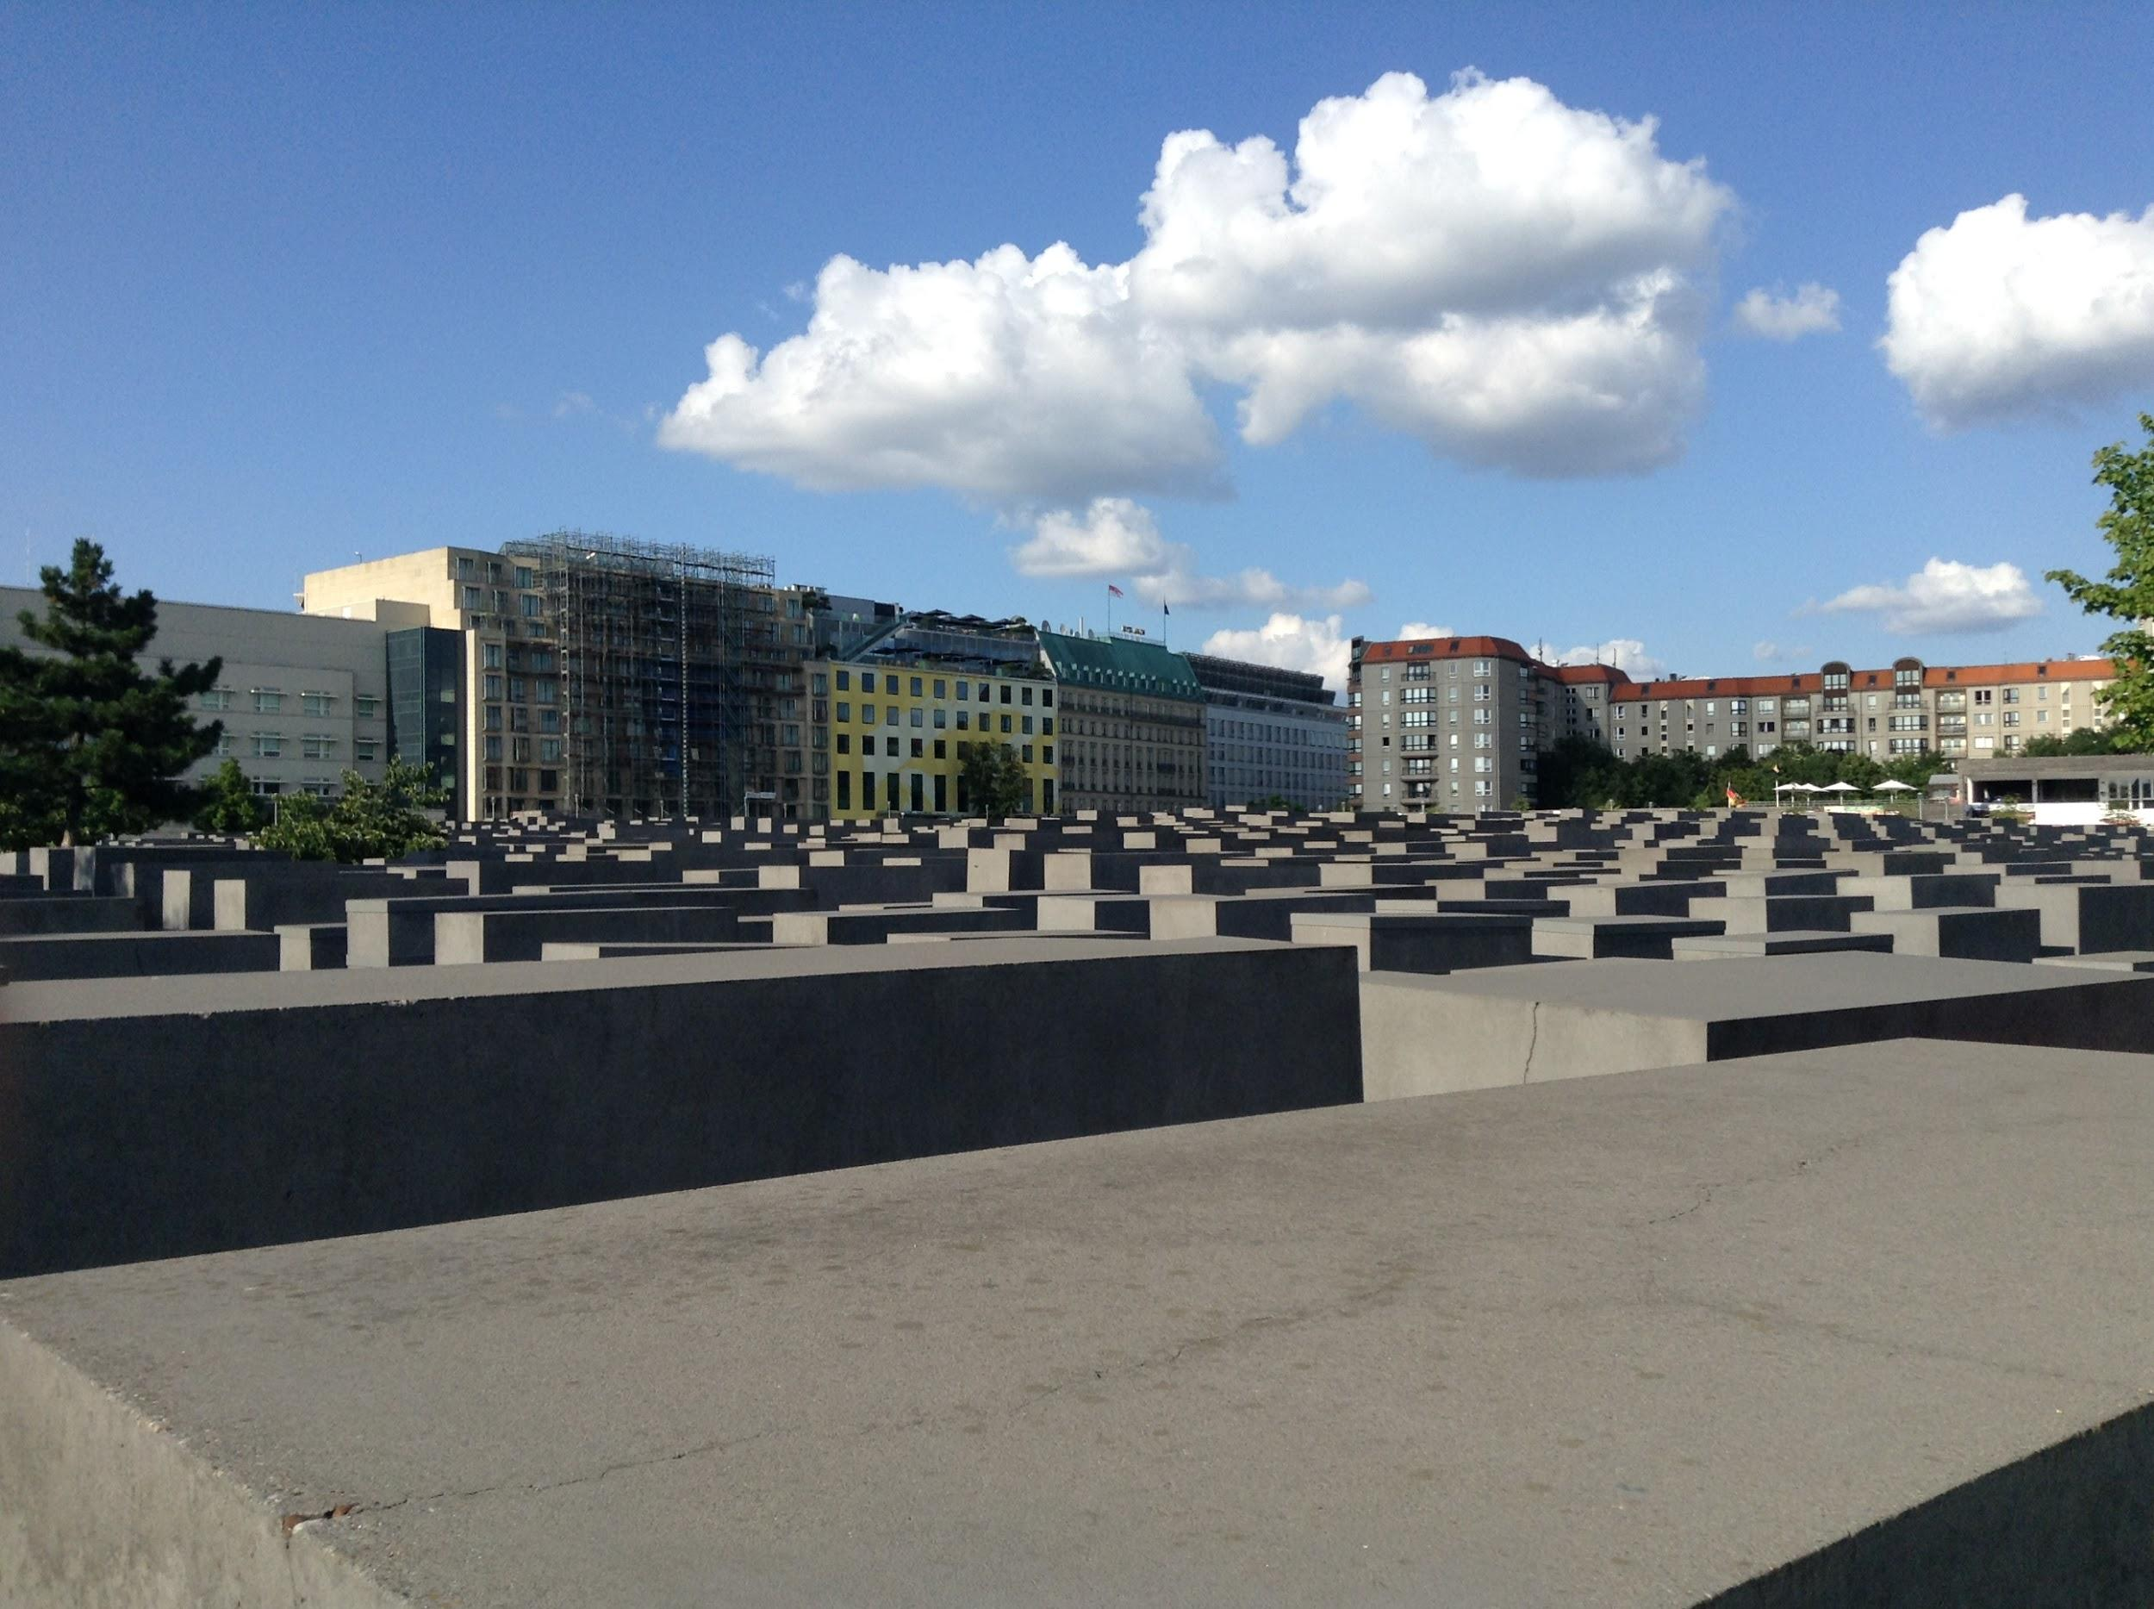
Memorial to the Jews

Slide 21
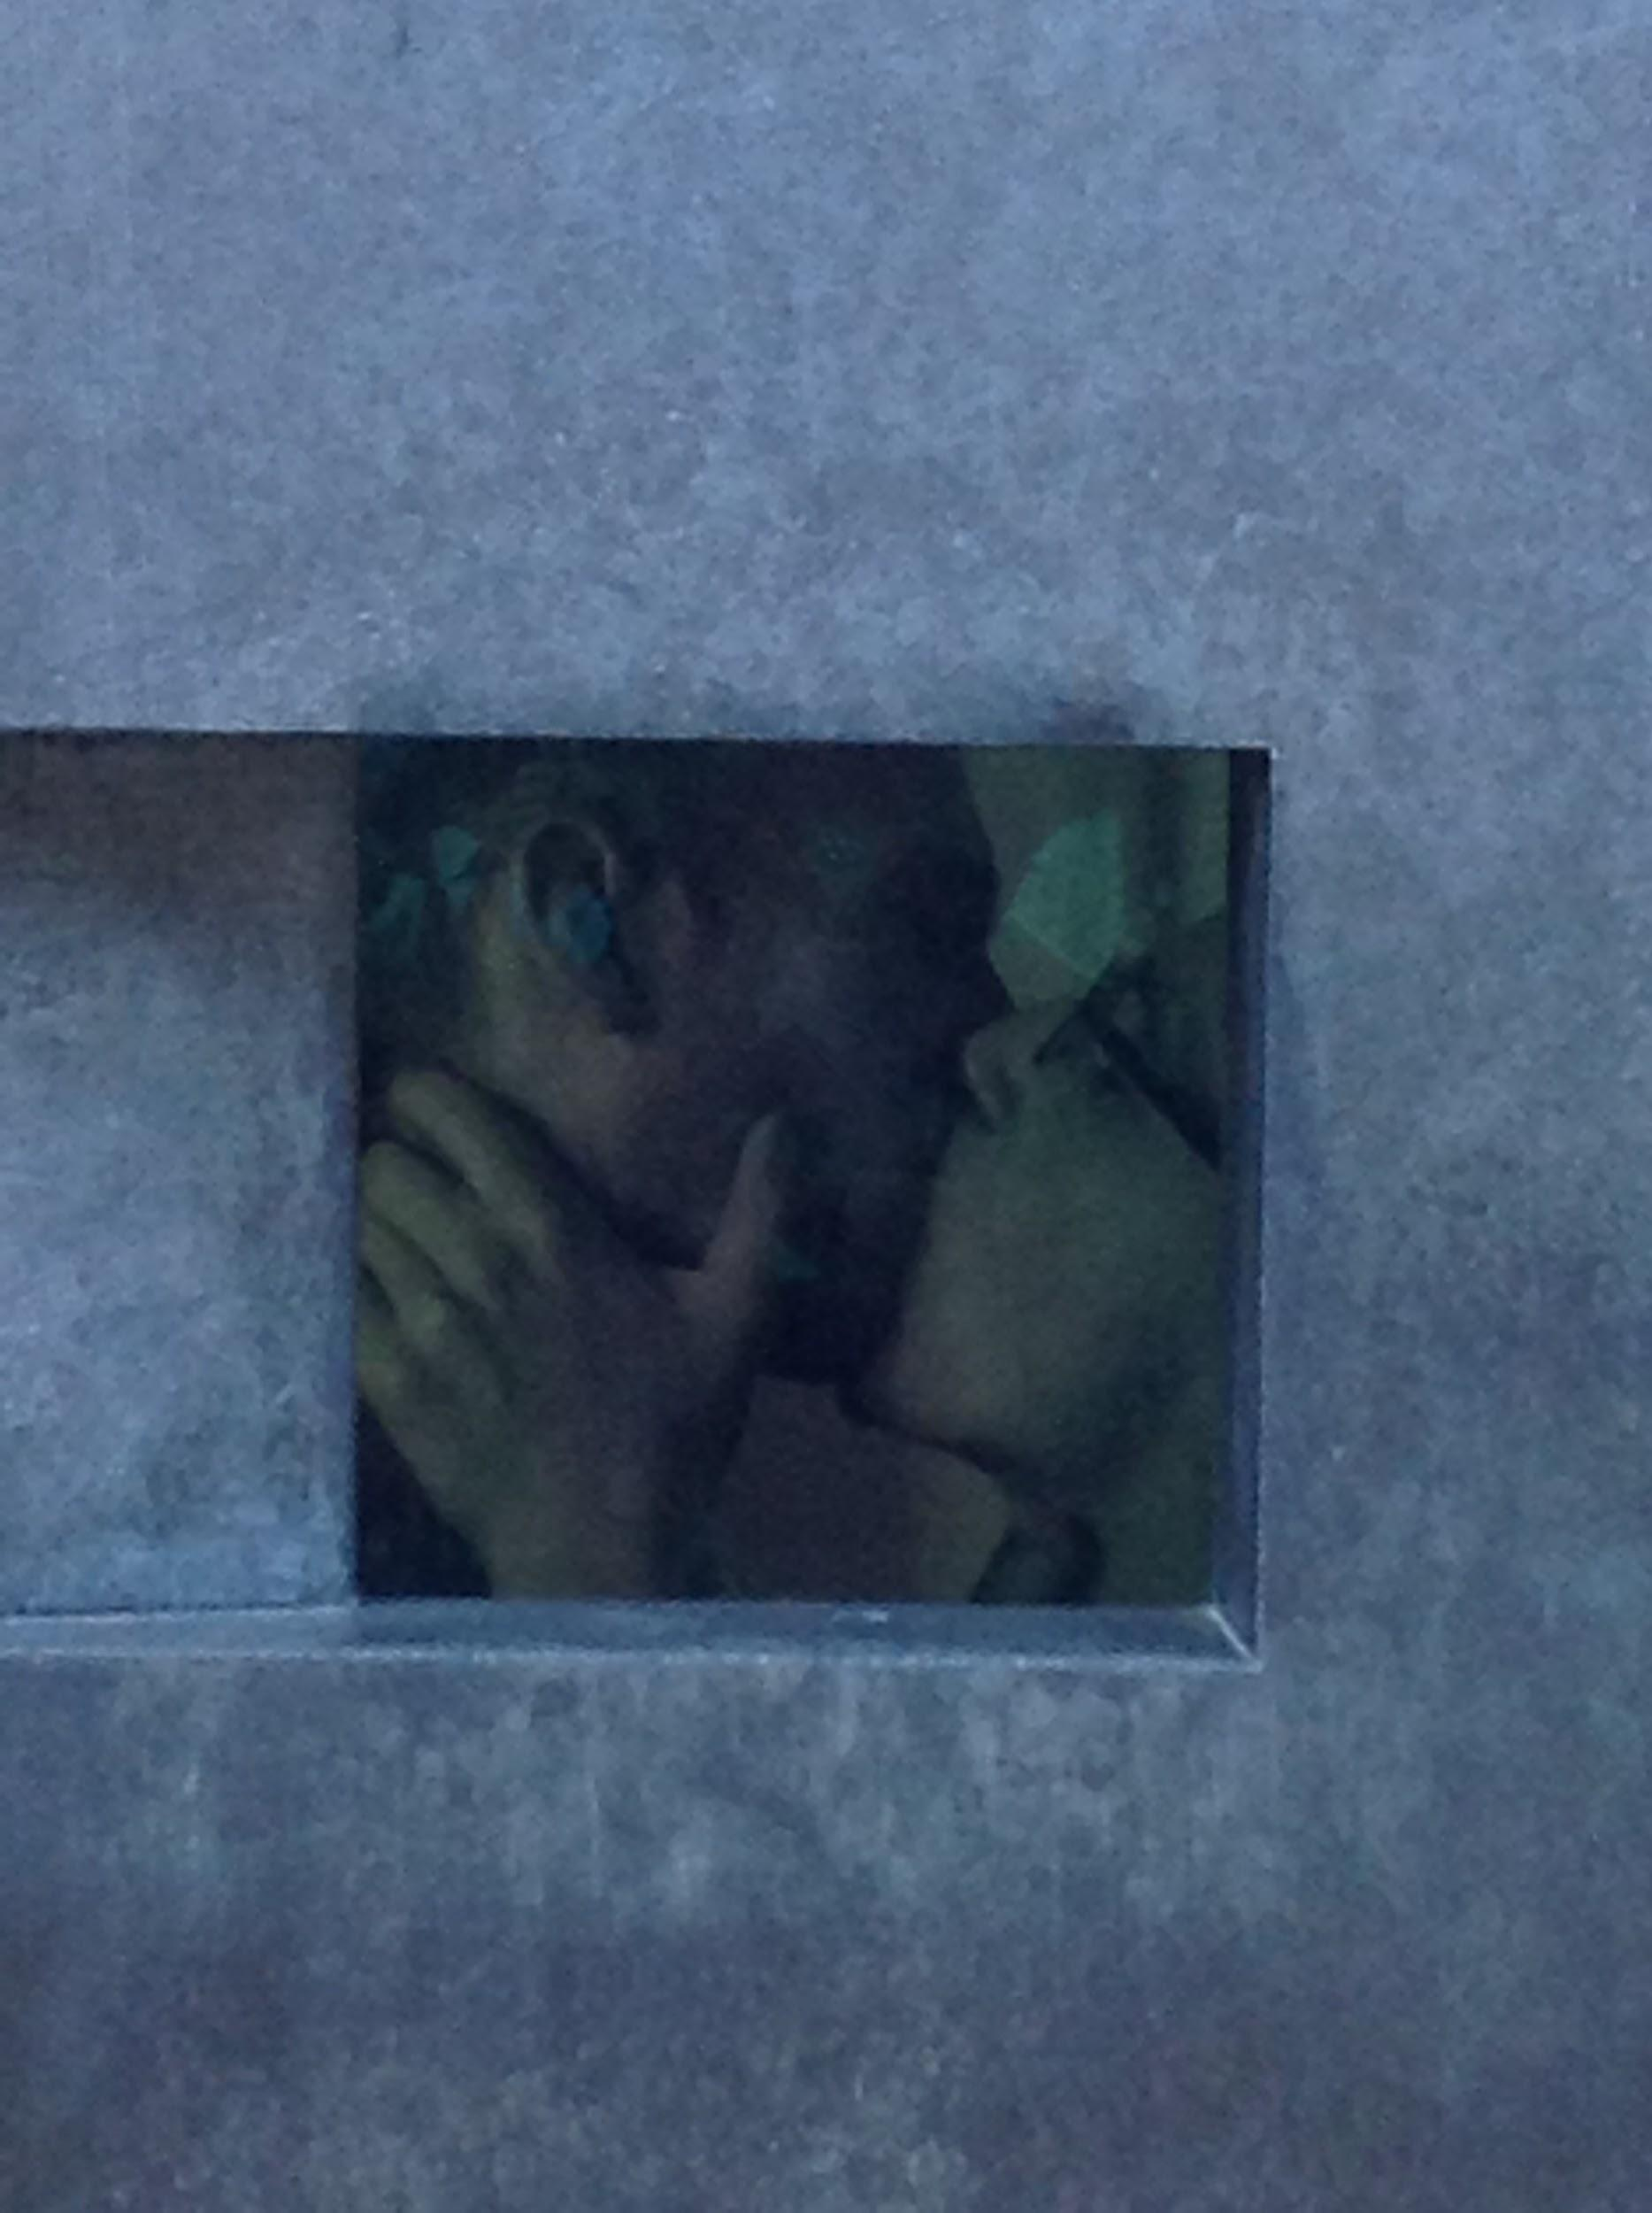
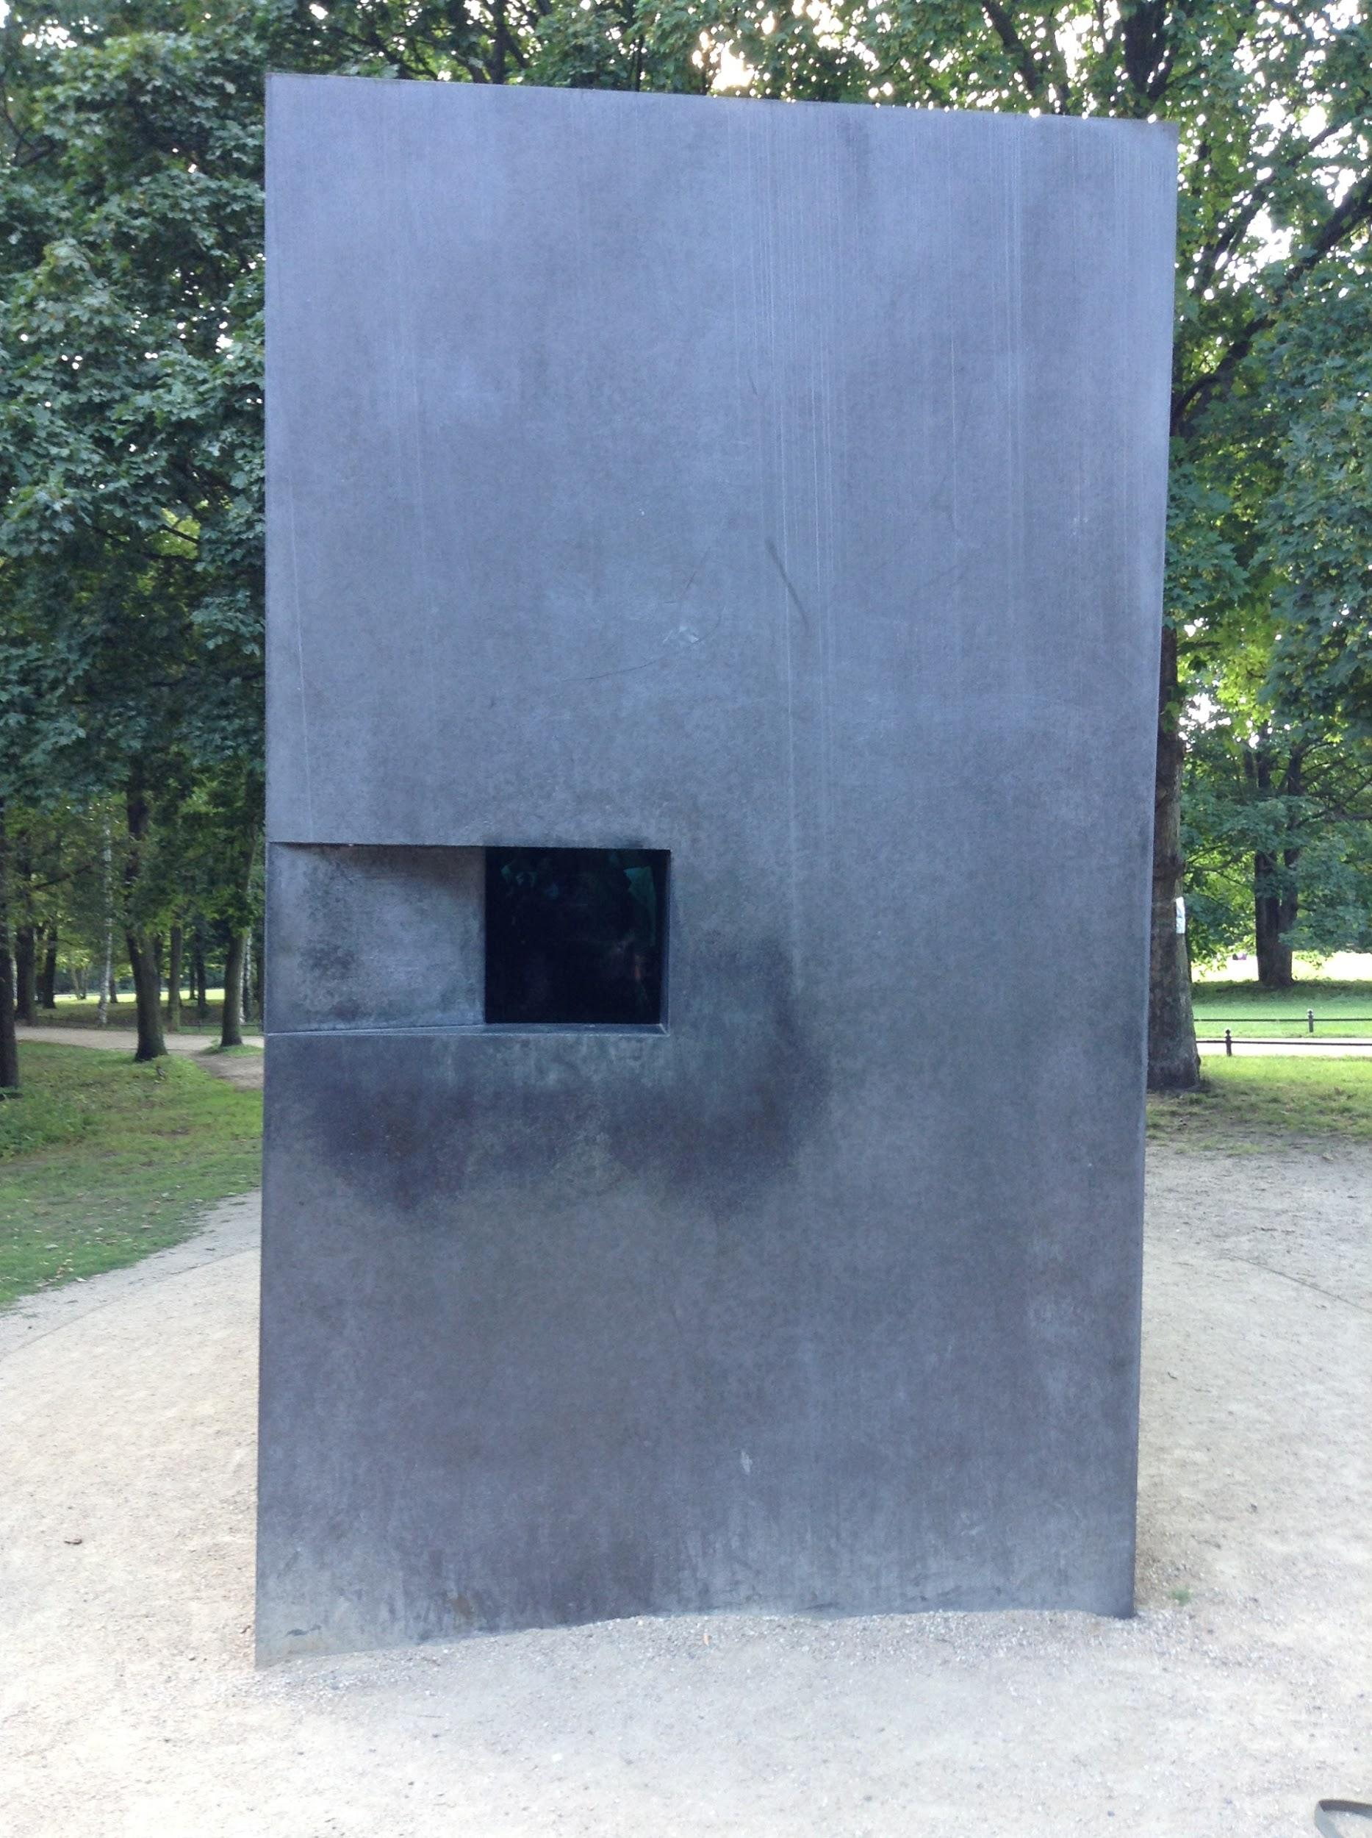
Memorial to the Homosexuals

Slide 22
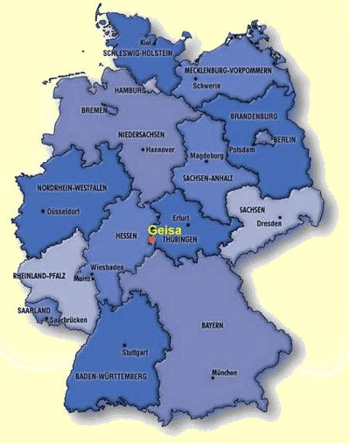
Geisa: Point Alpha

Slide 23
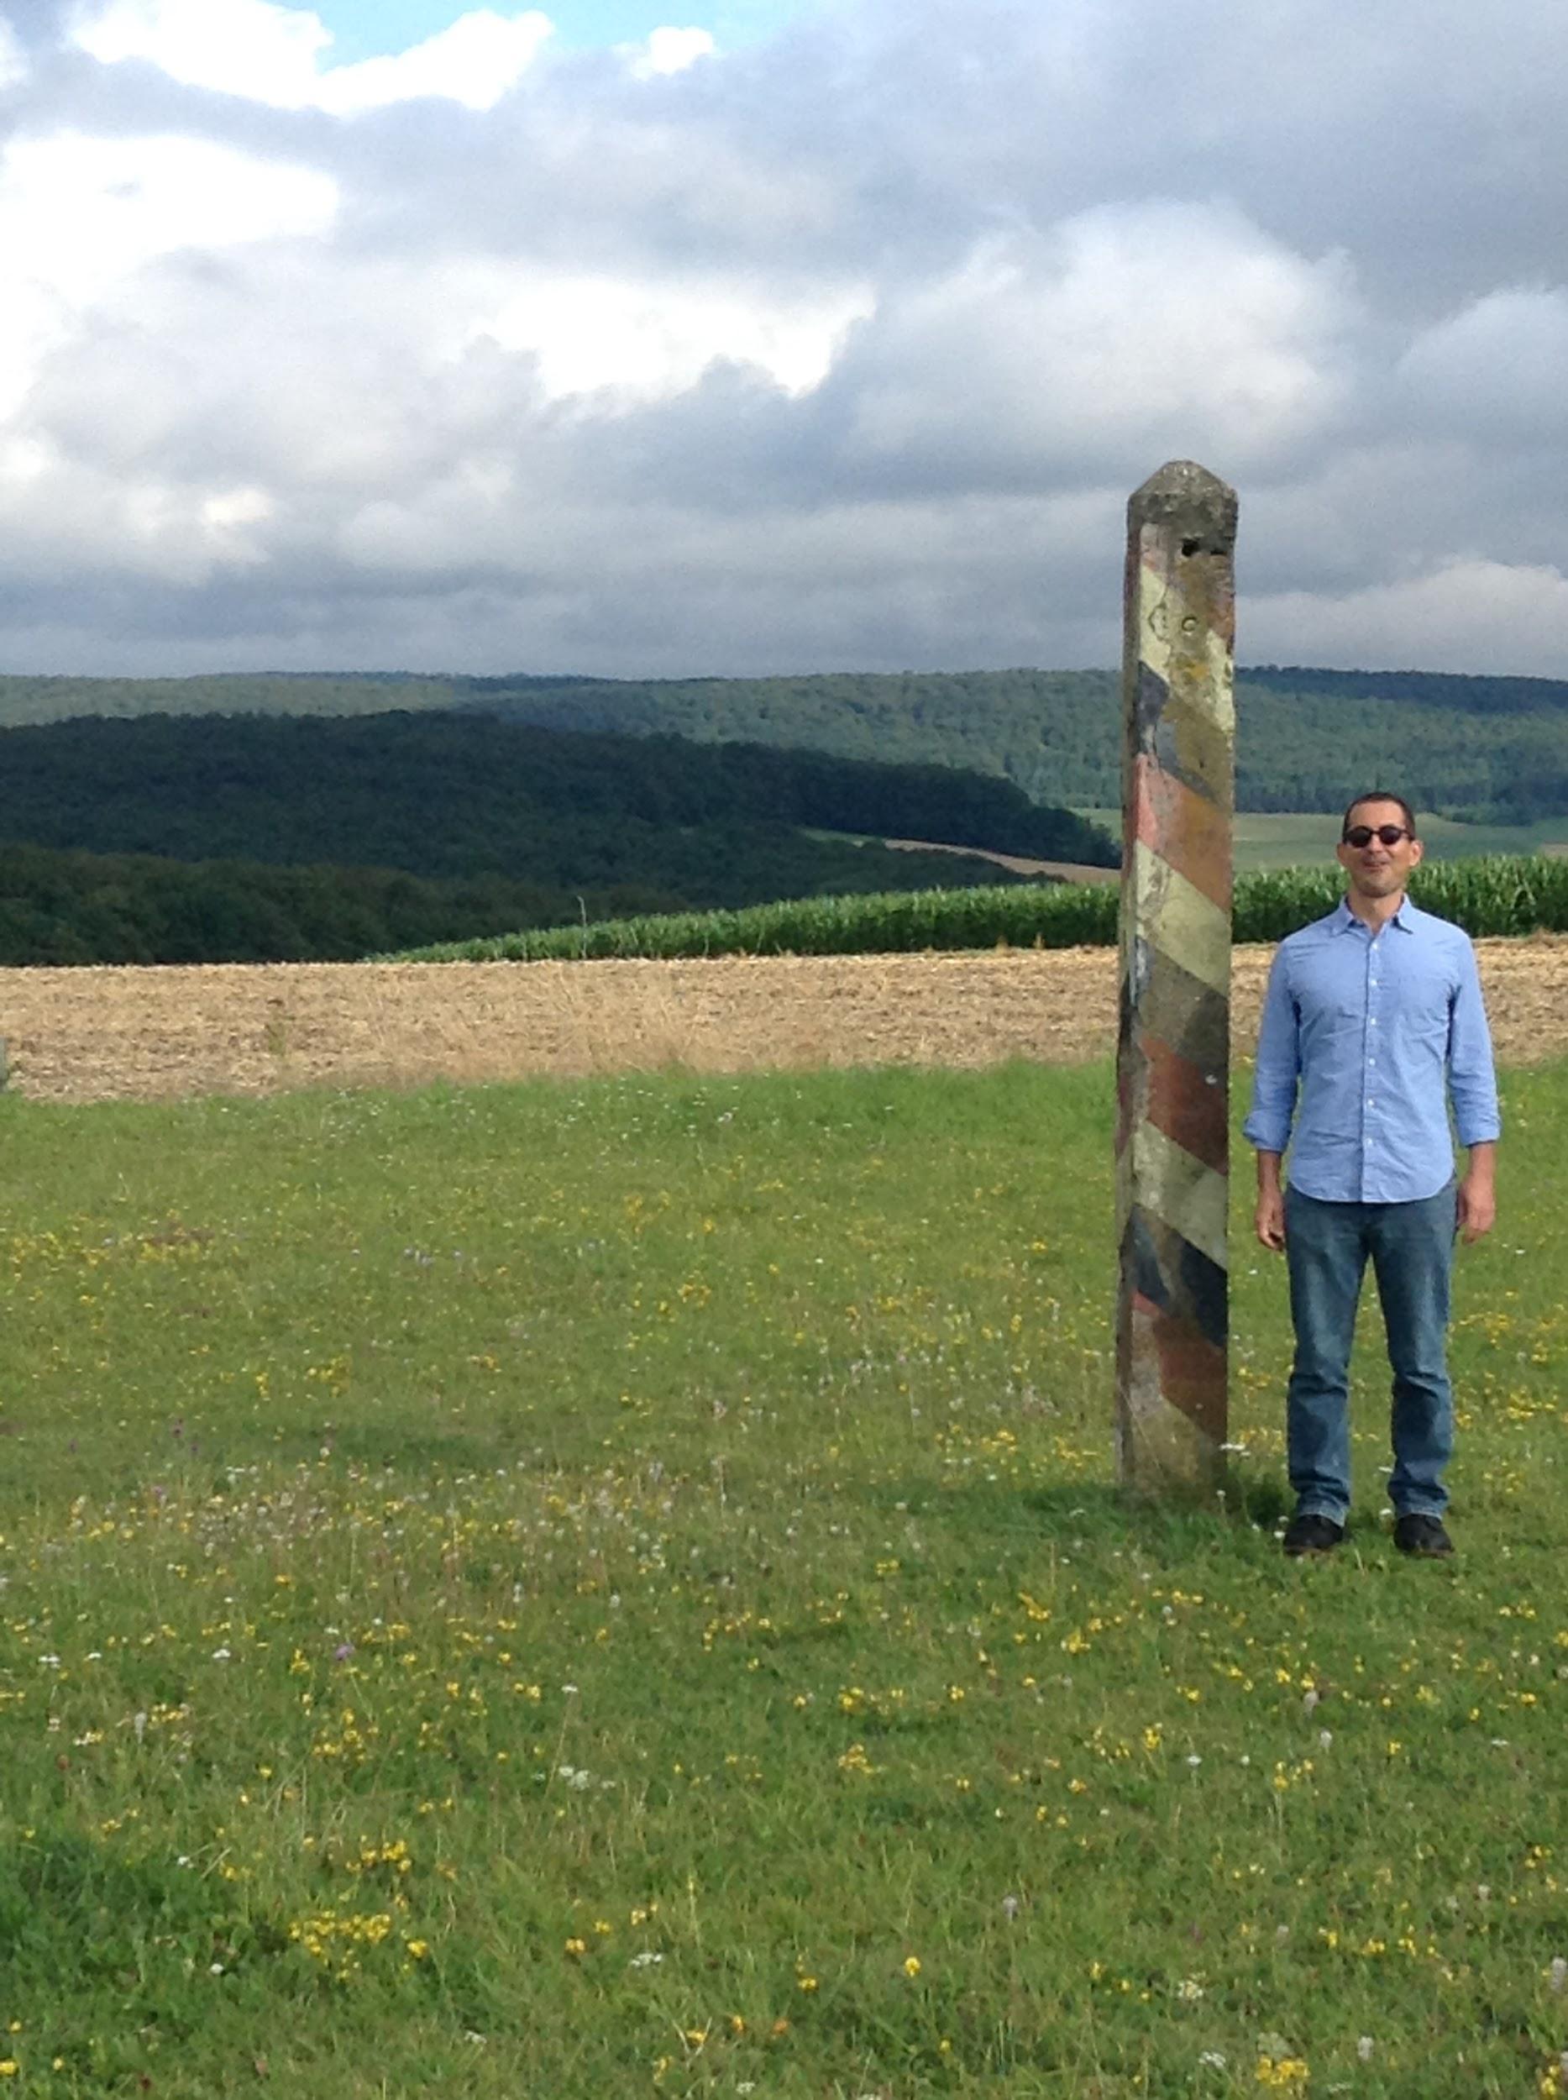
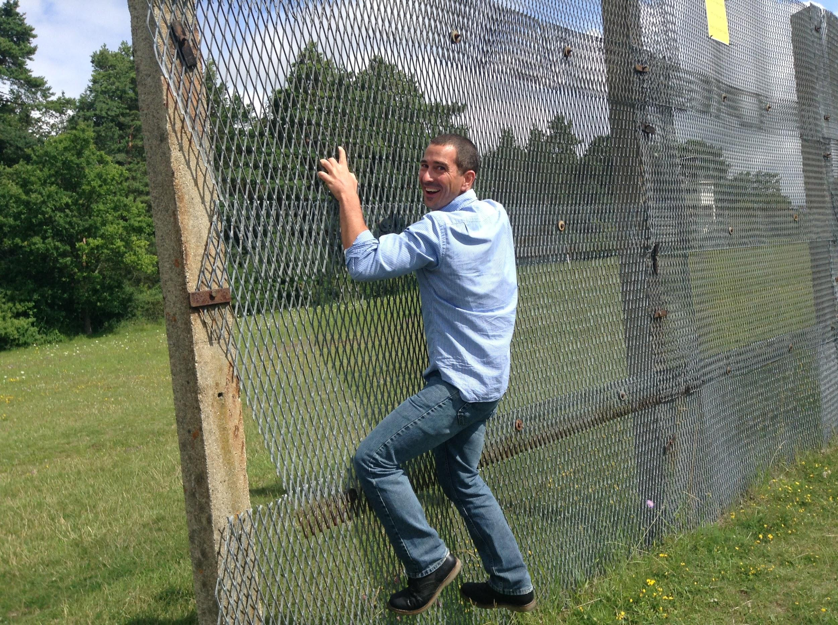

Slide 24
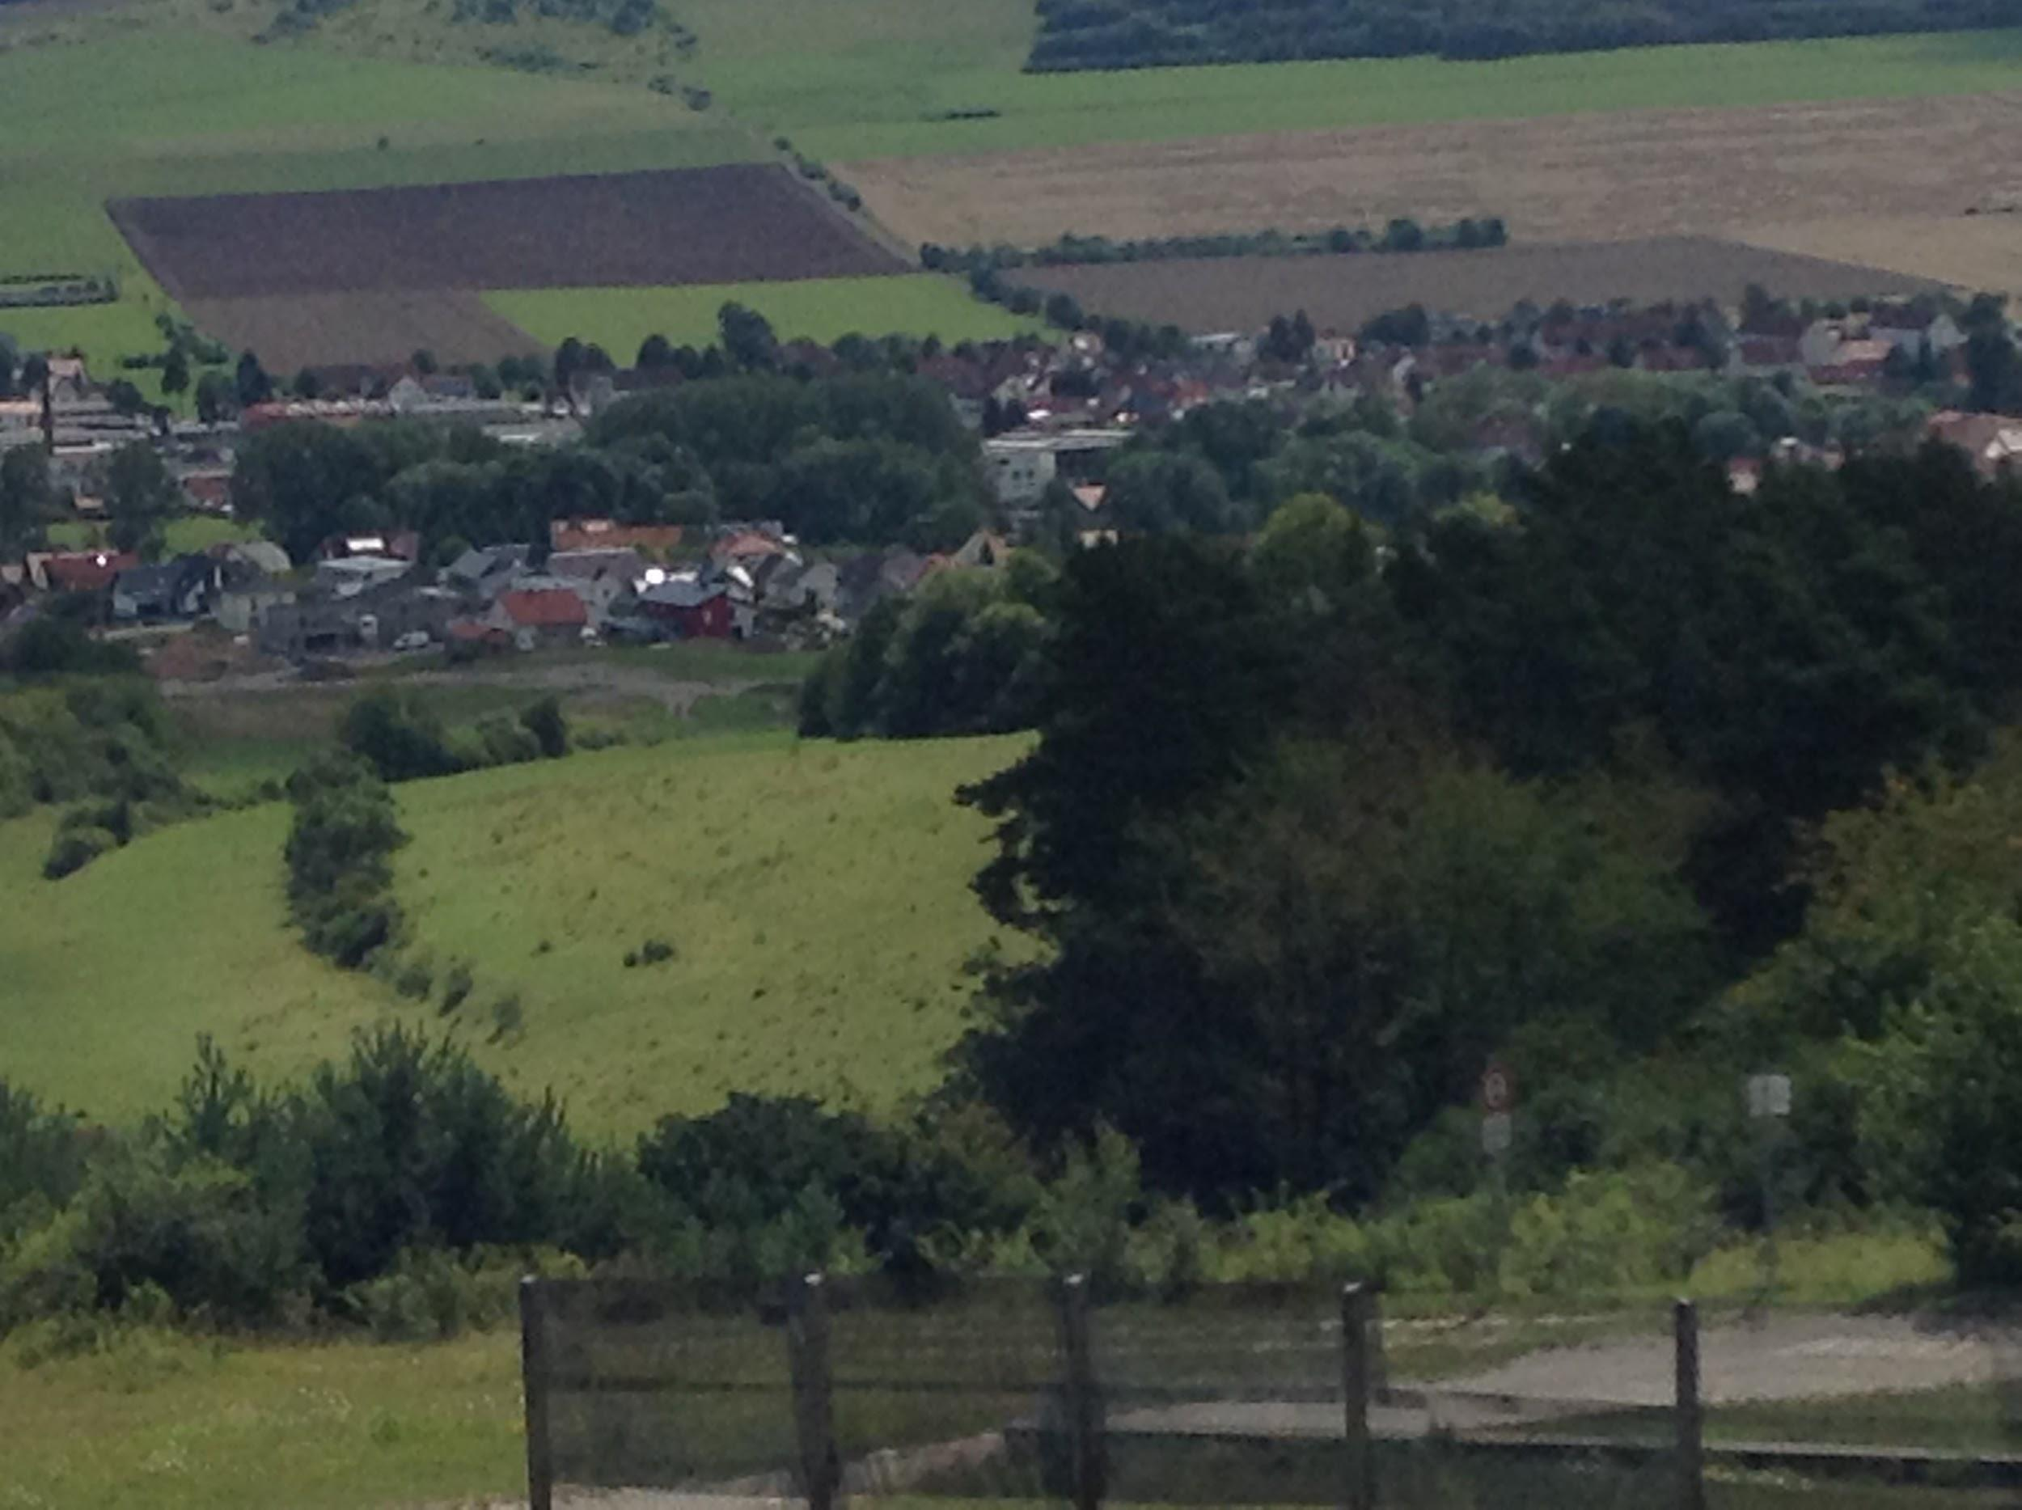
View from the West’s lookout tower

Slide 25
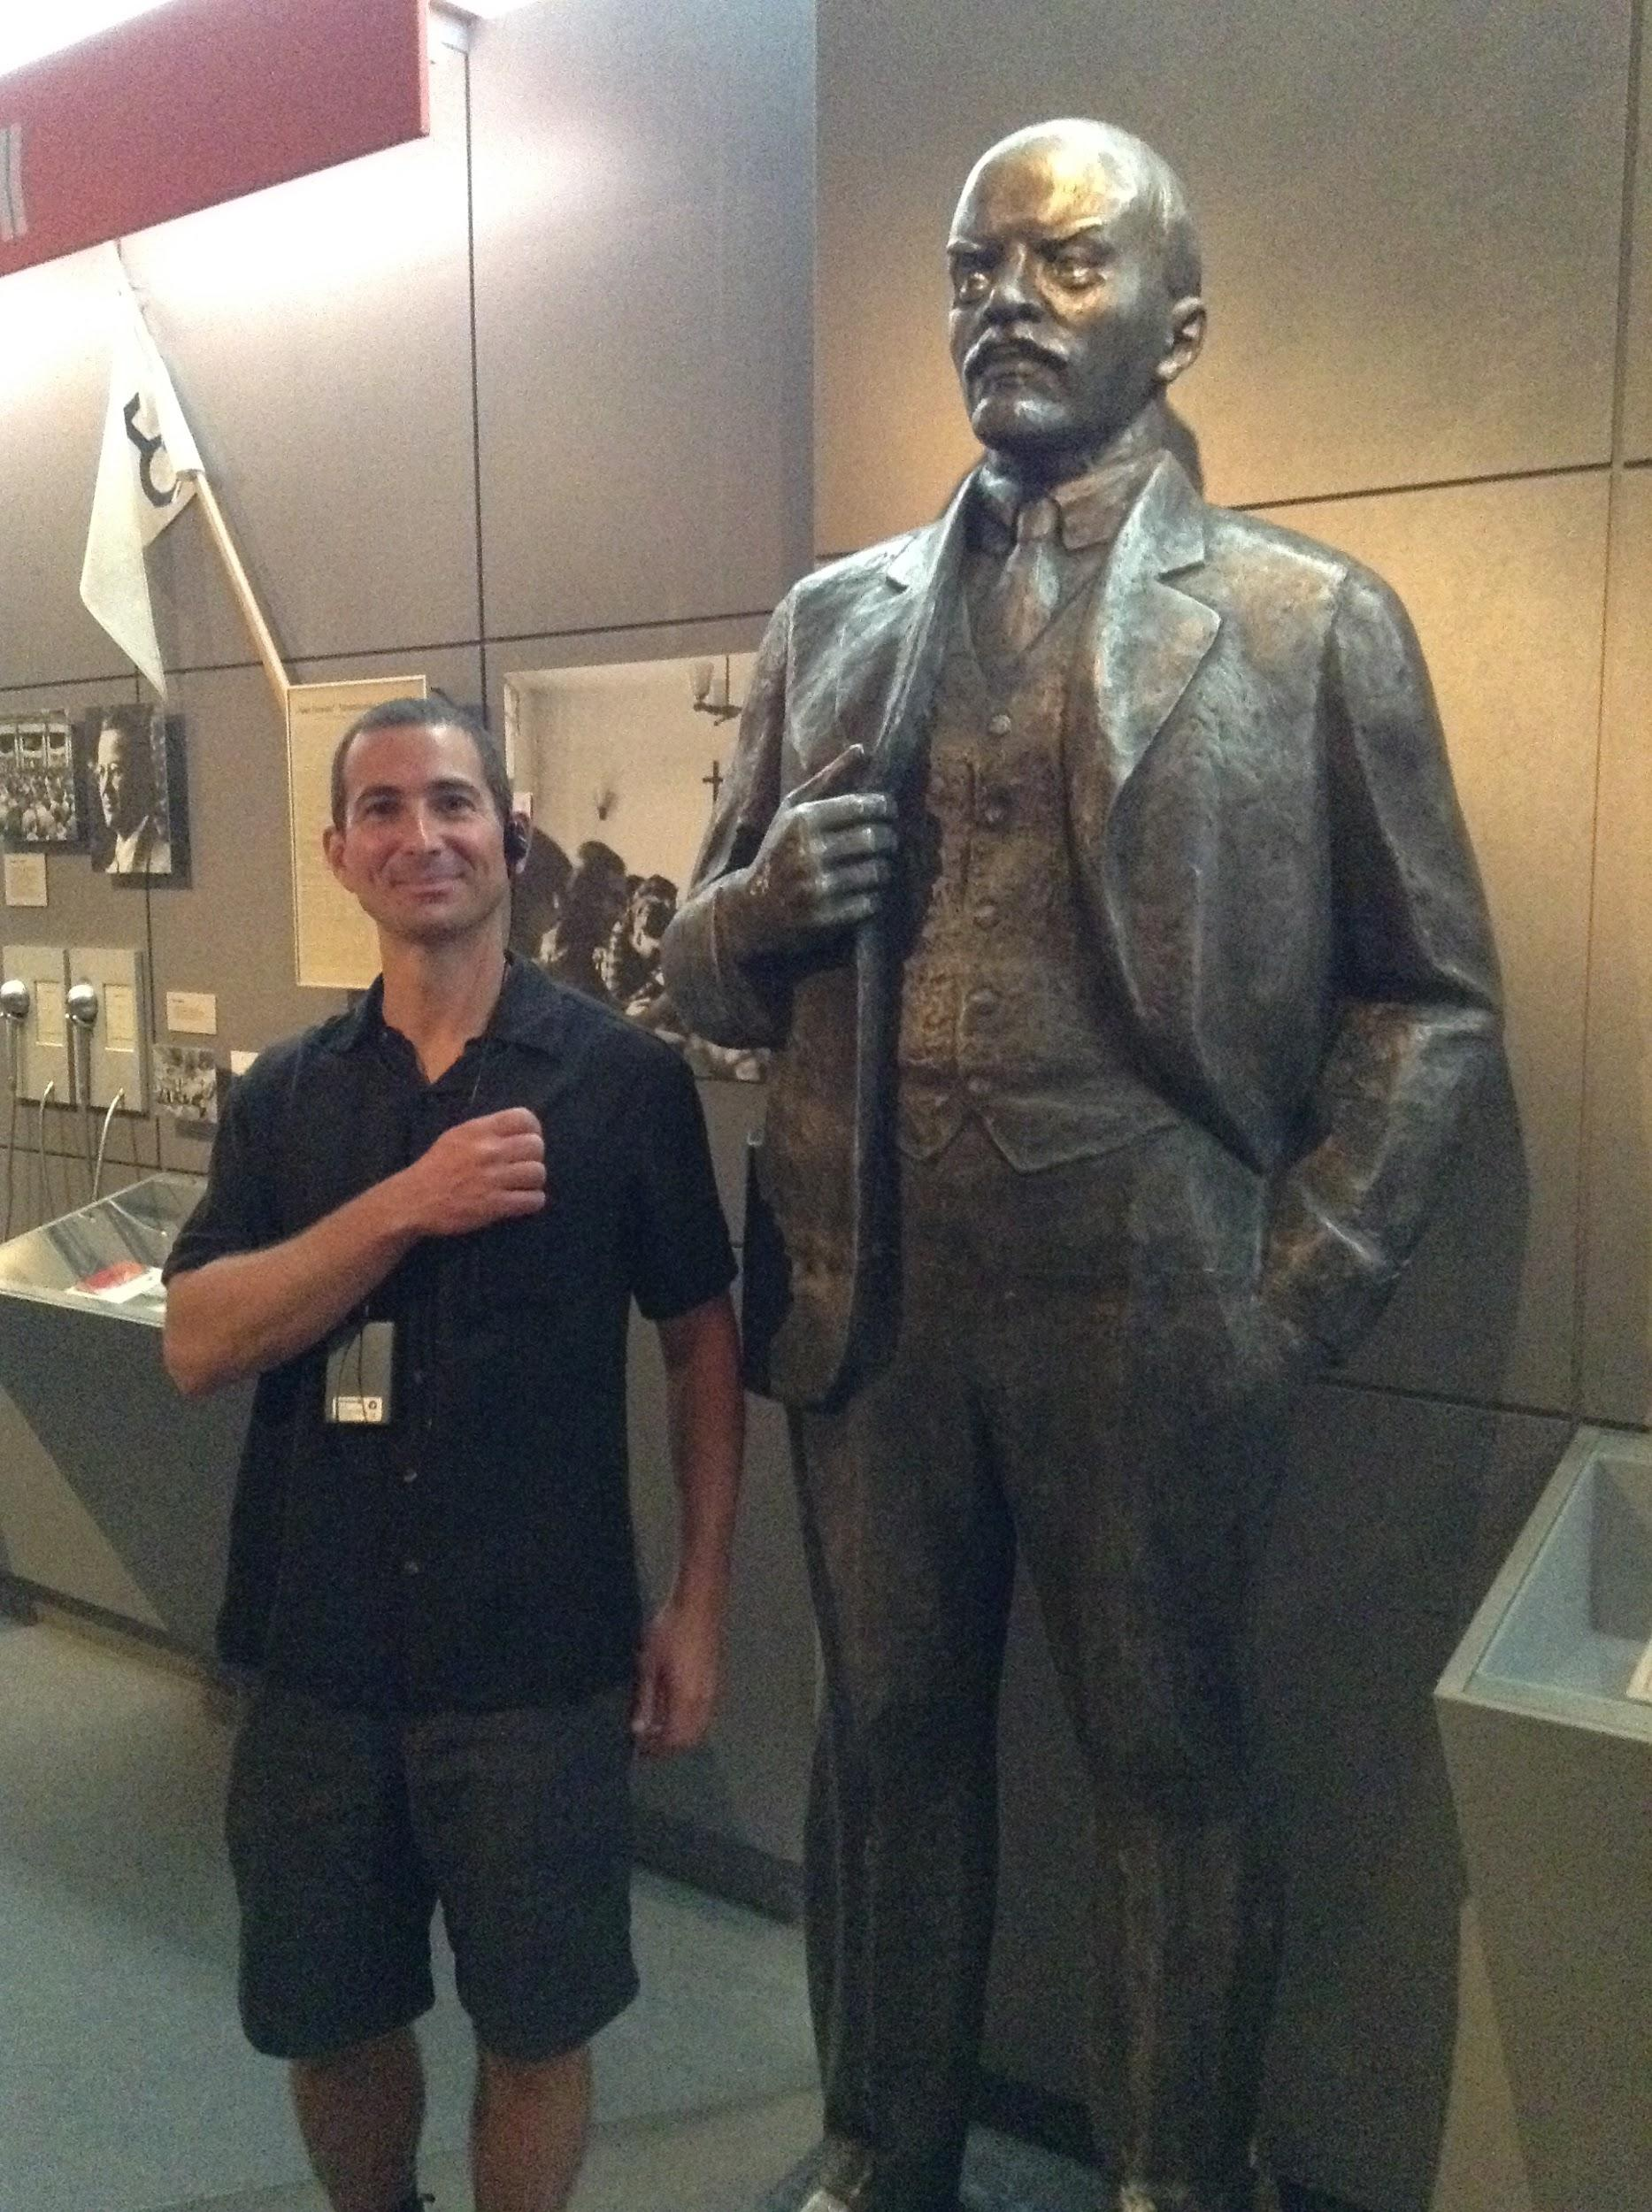
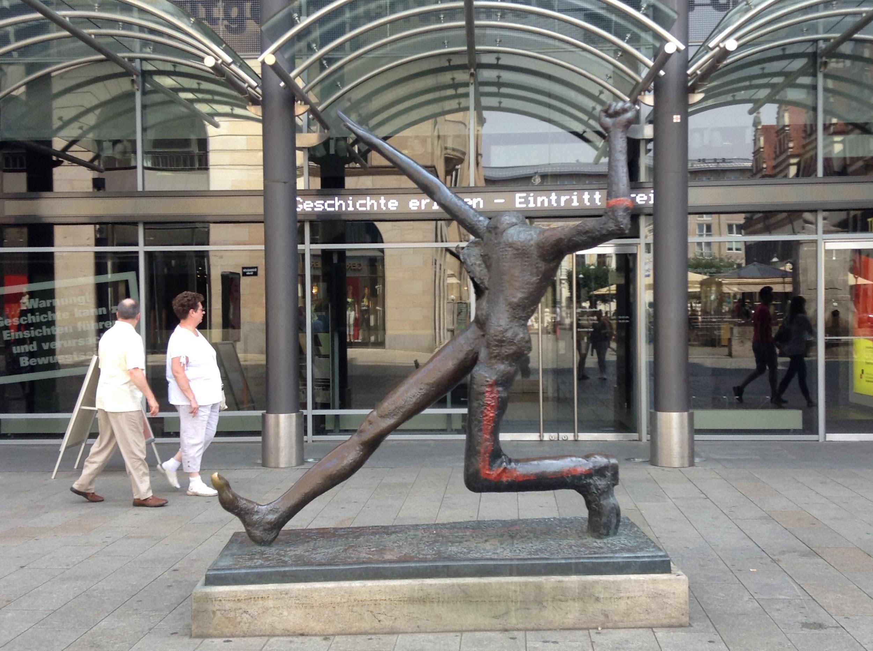
Leipzig and Revolution

Slide 26
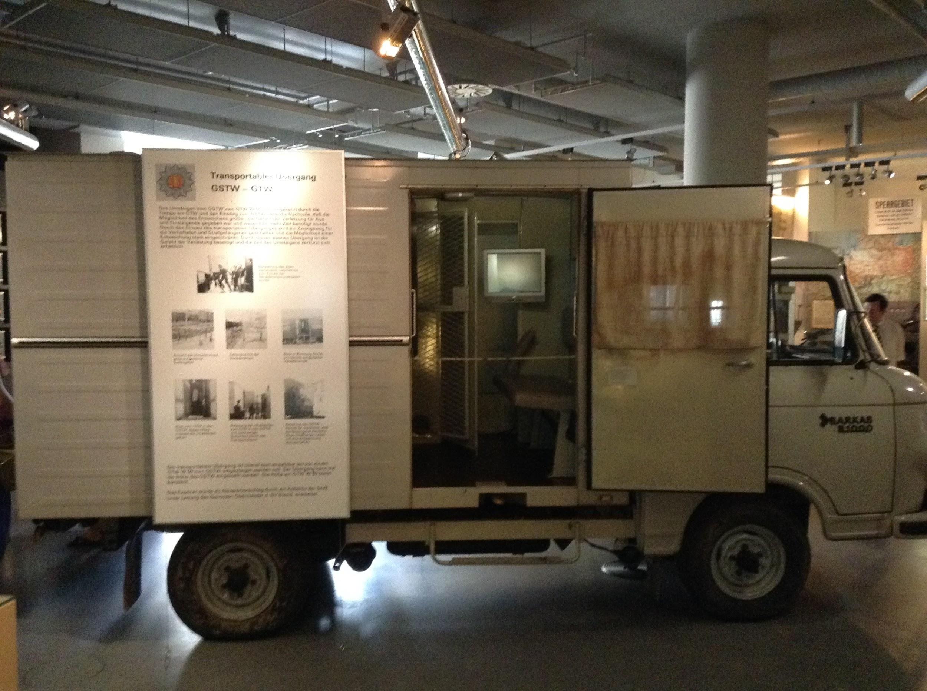
Fuck the Stasi

Slide 27
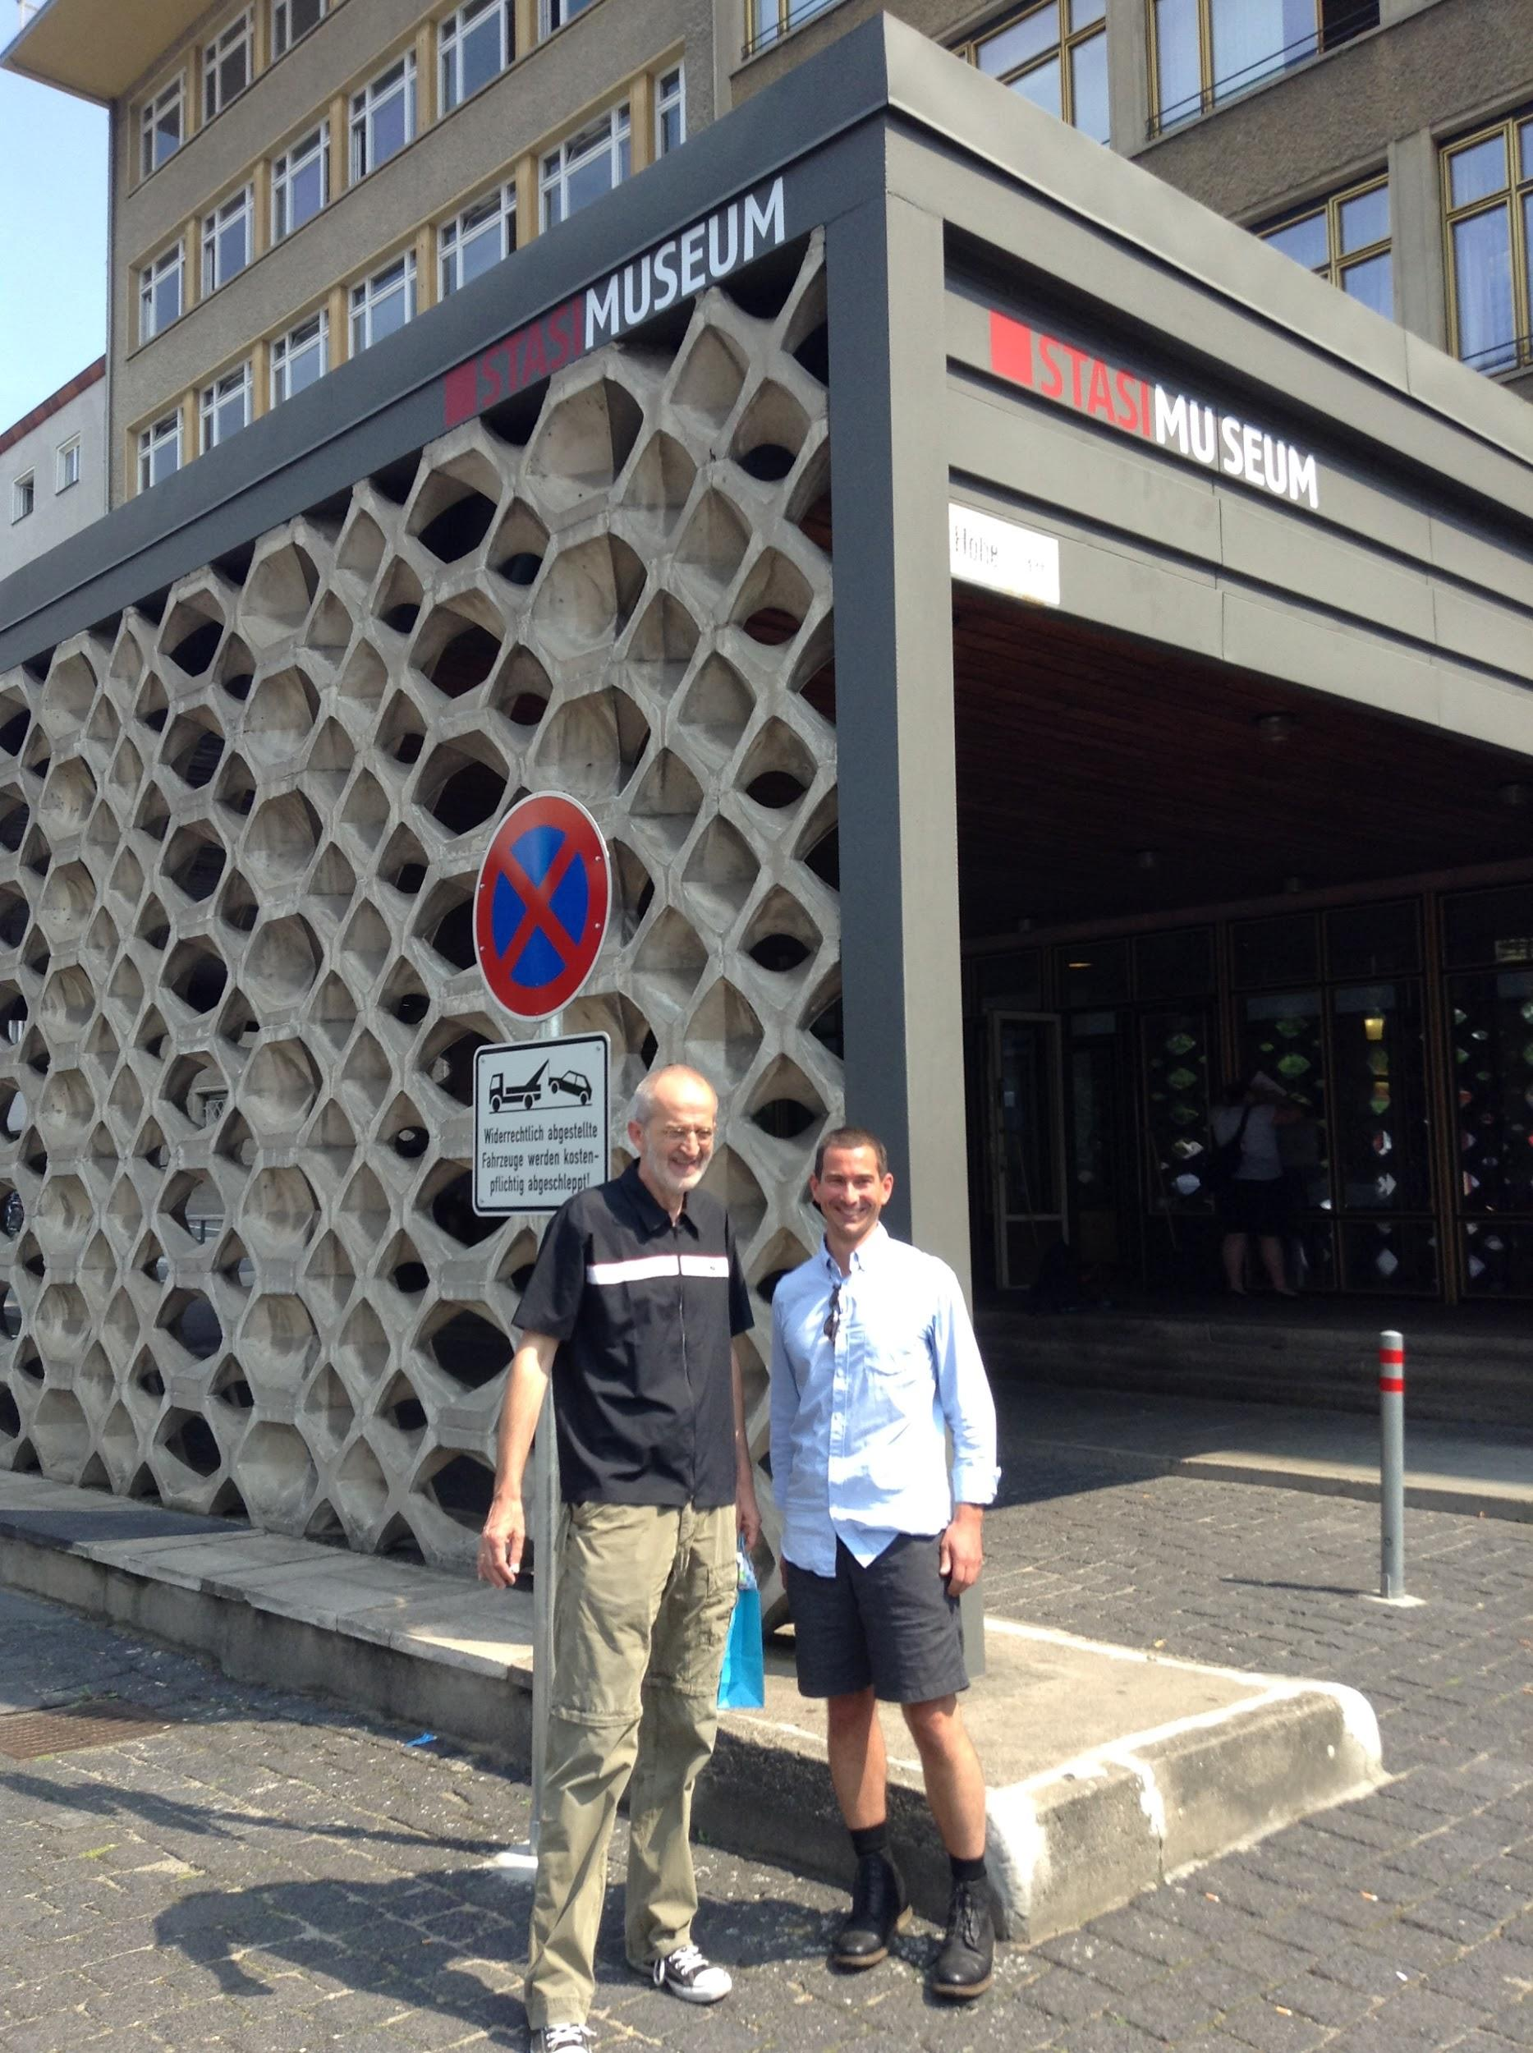
Berlin: Stasi

Slide 28
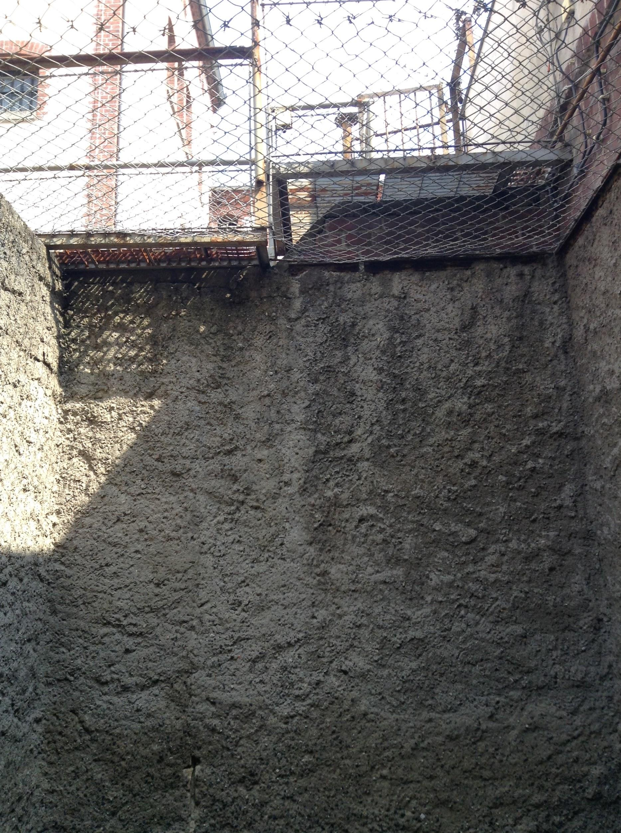
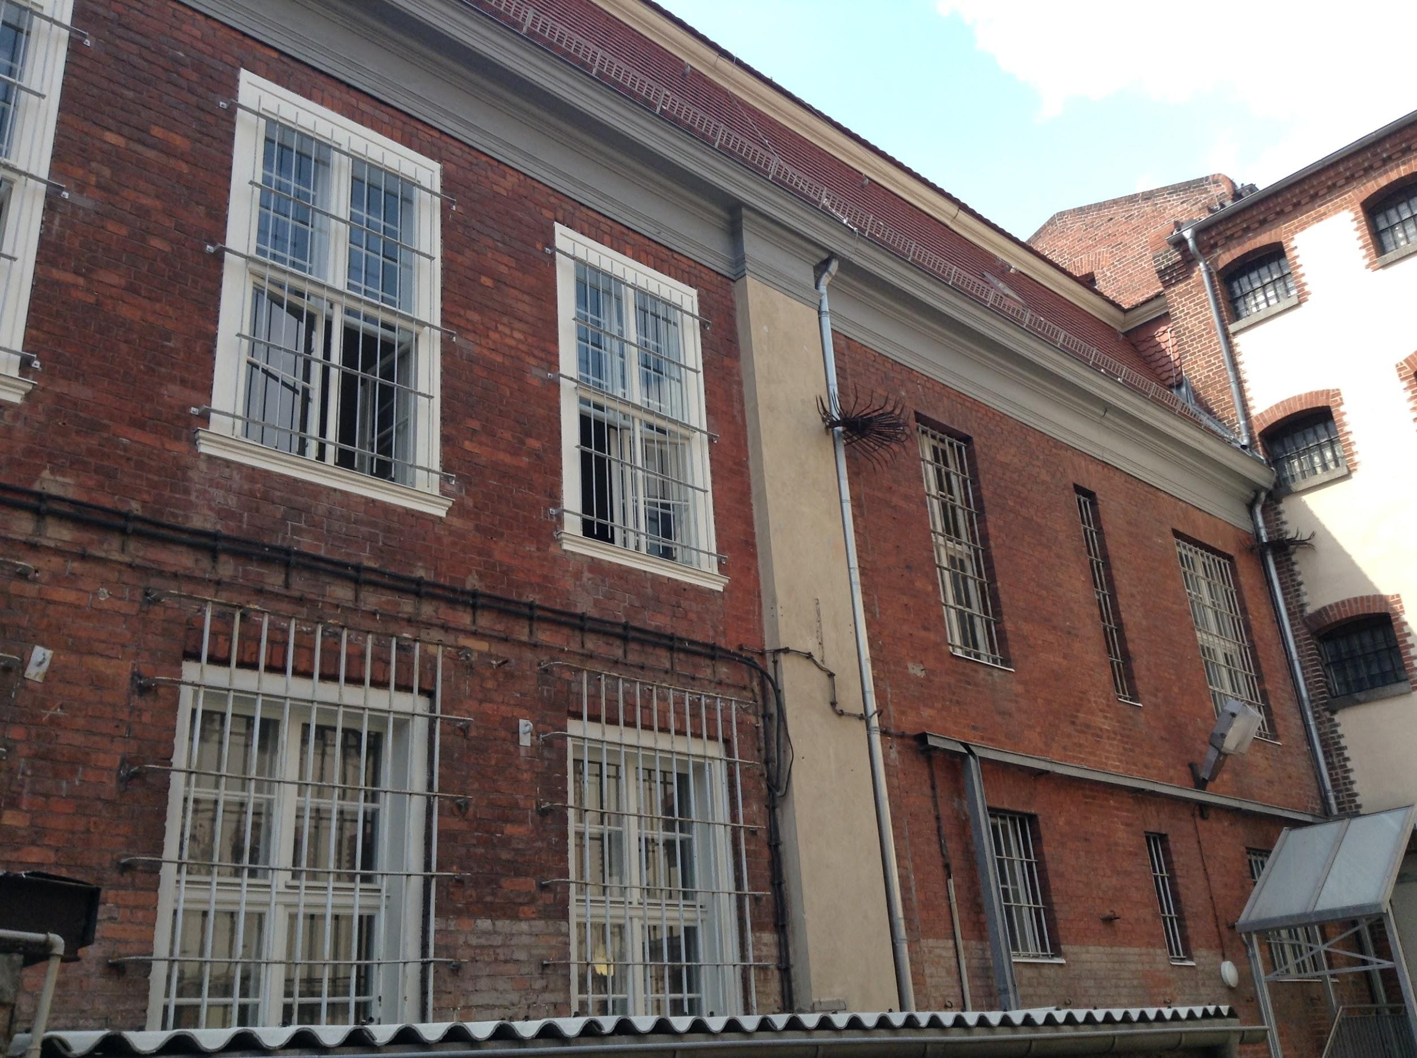
Potsdam Prison

Slide 29
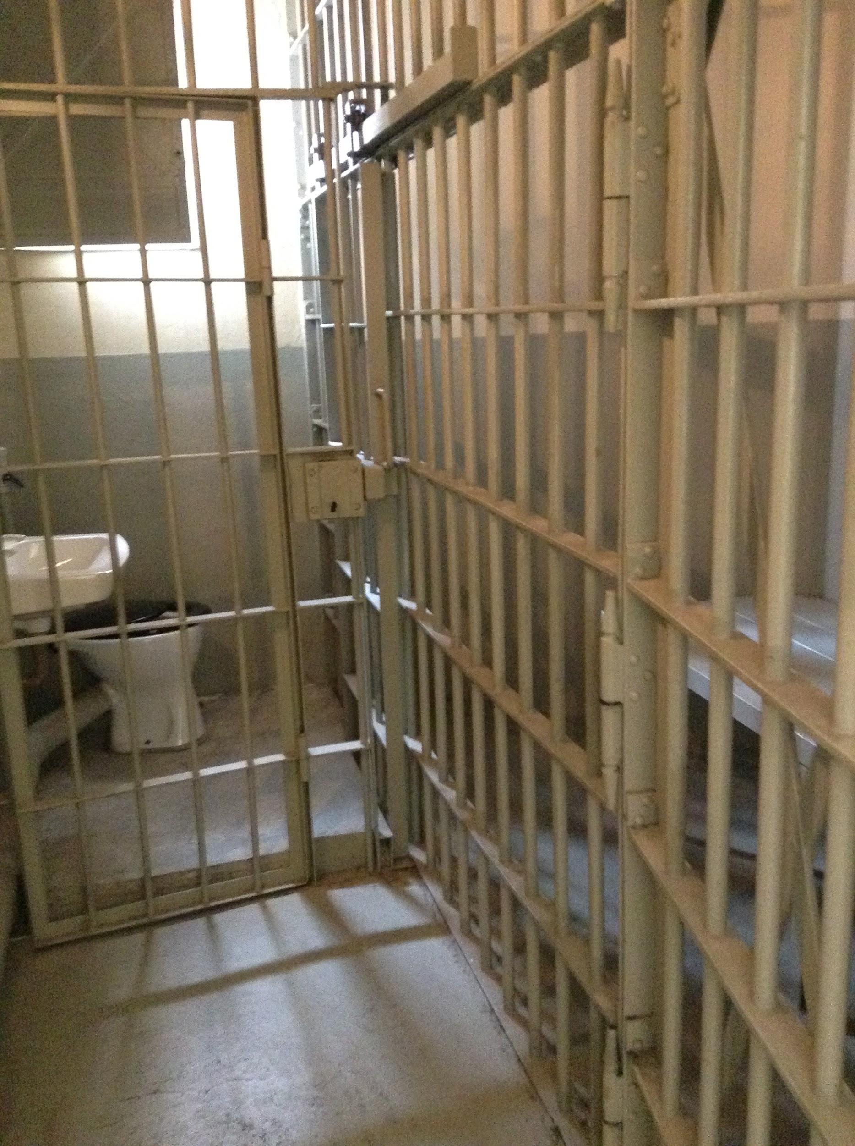
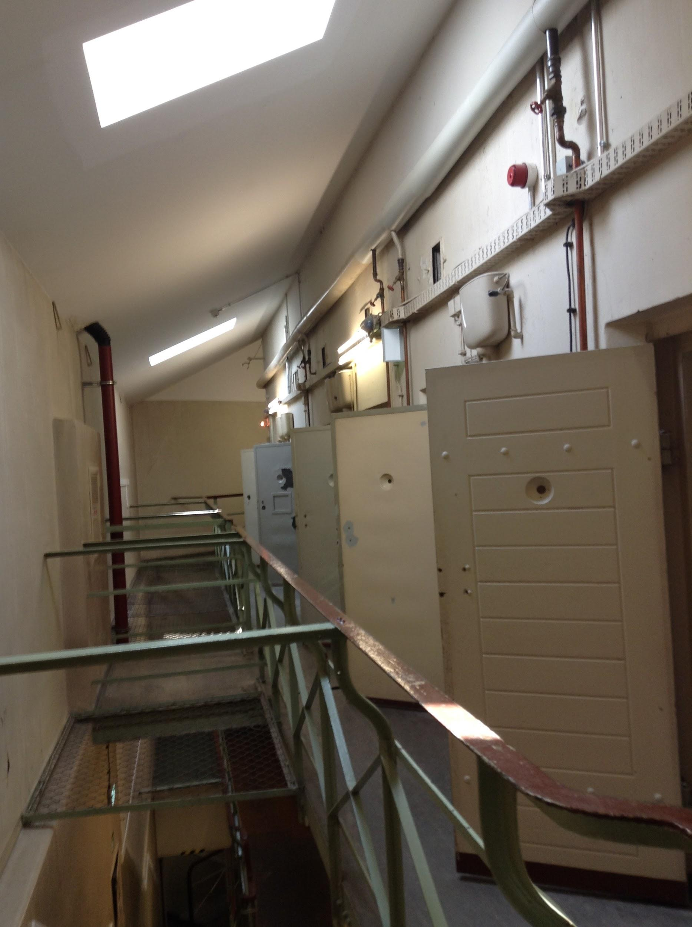

Slide 30
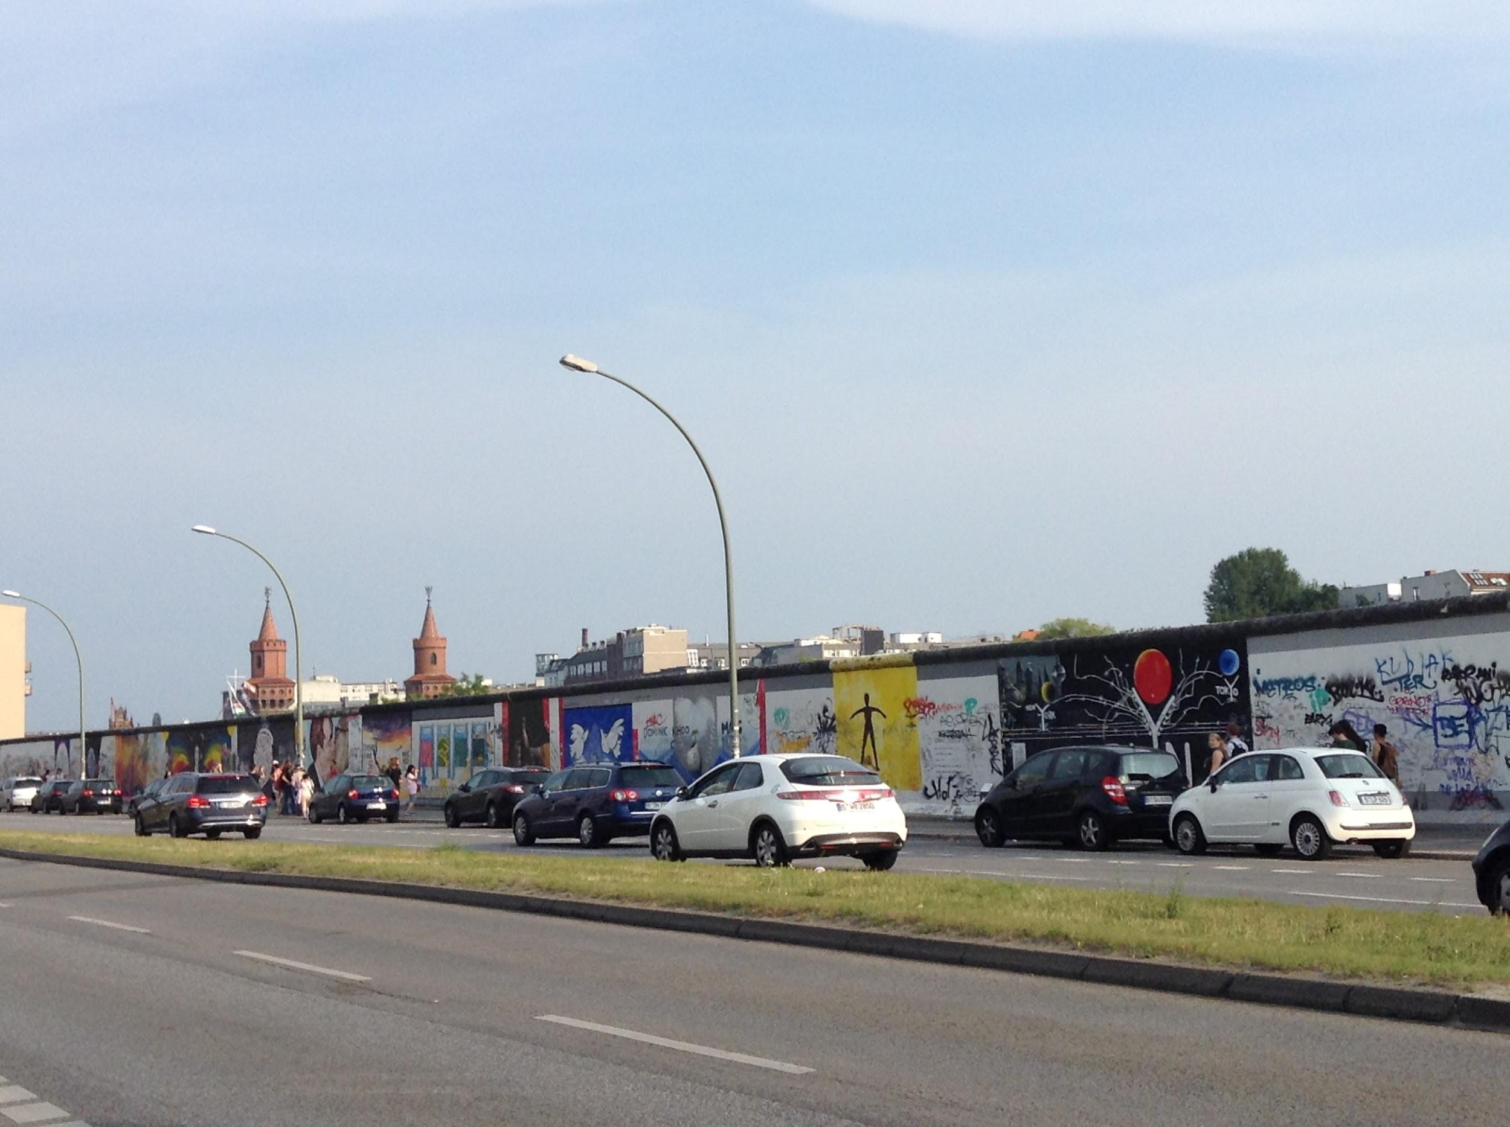
Berlin:
Beautiful, Tarnished Berlin

Slide 31
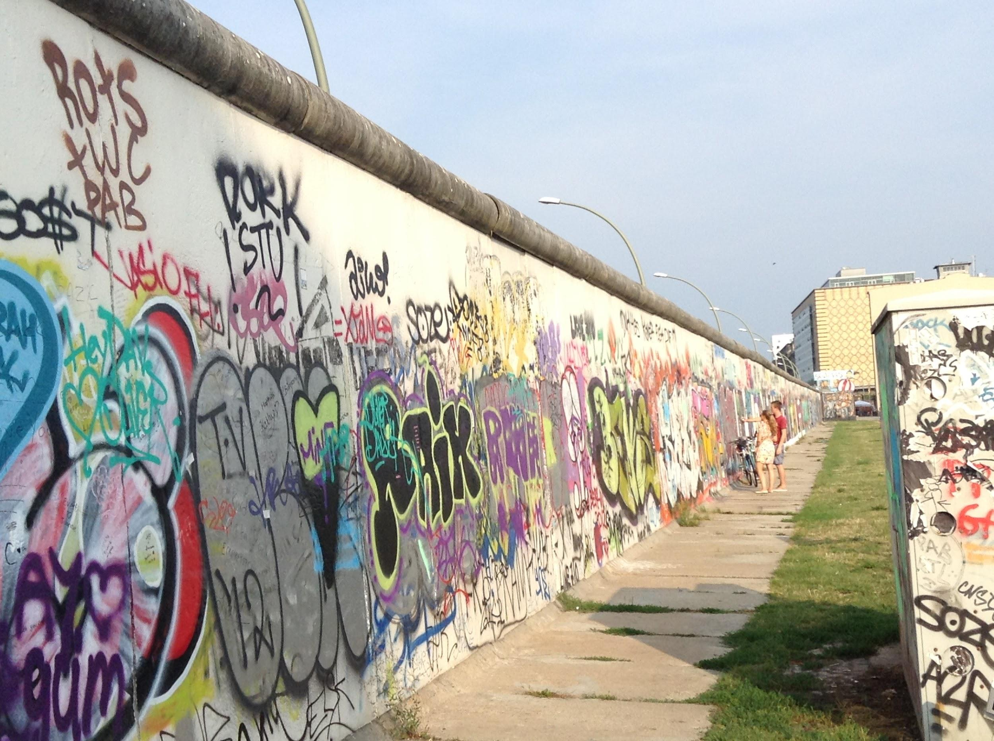

Slide 32
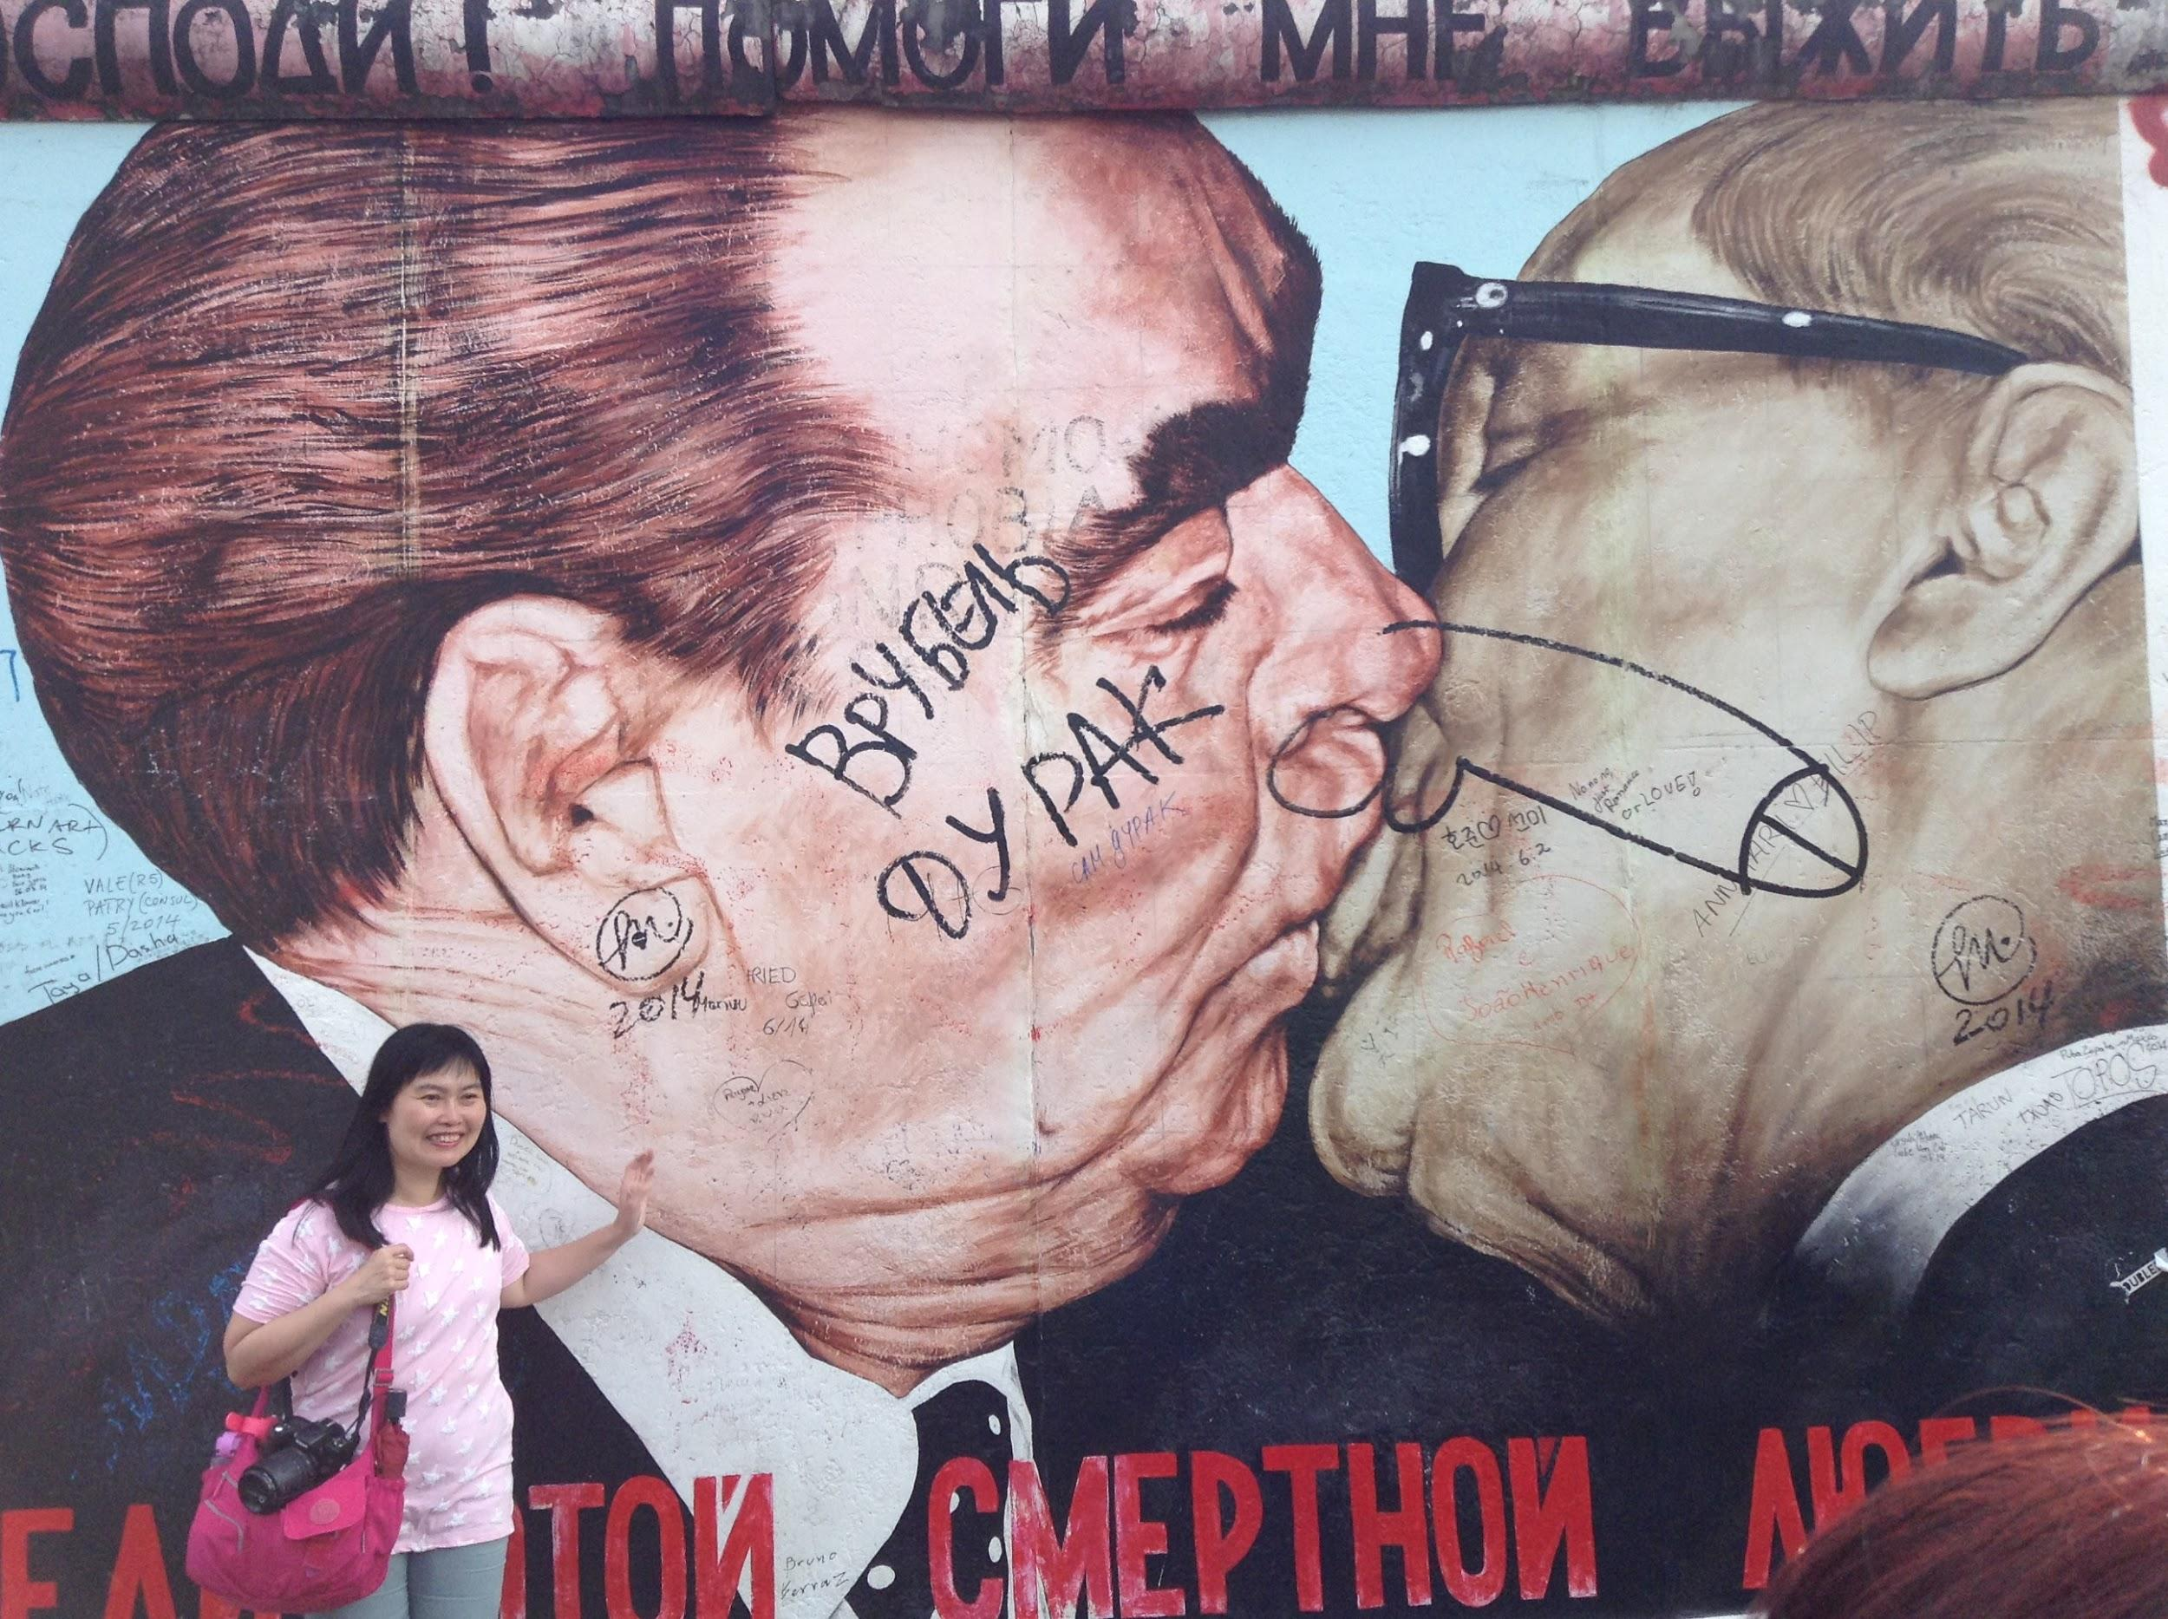
The Wall

Slide 33
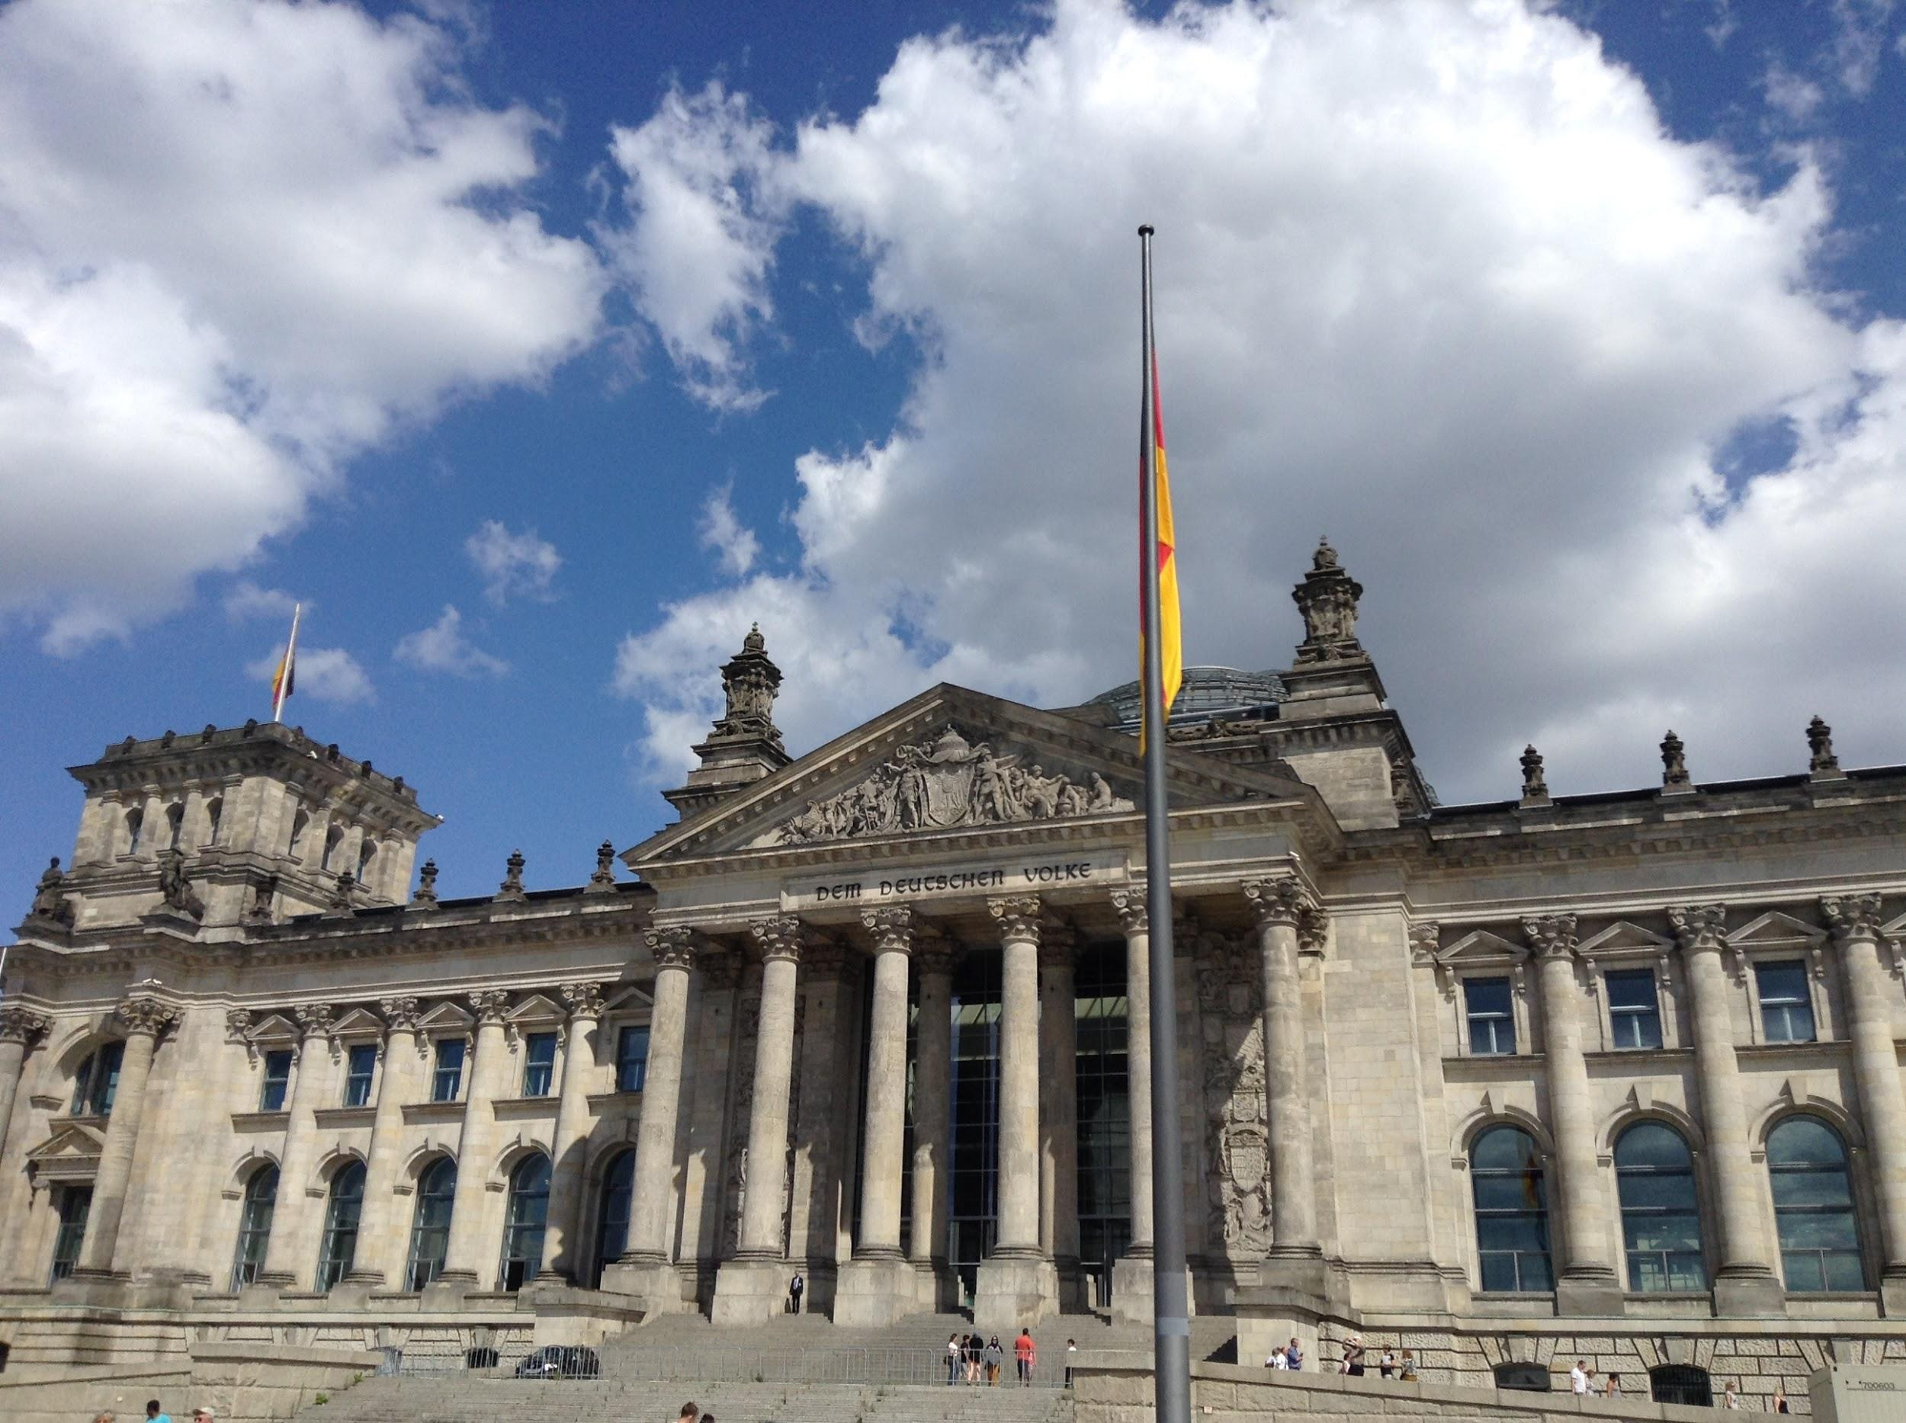
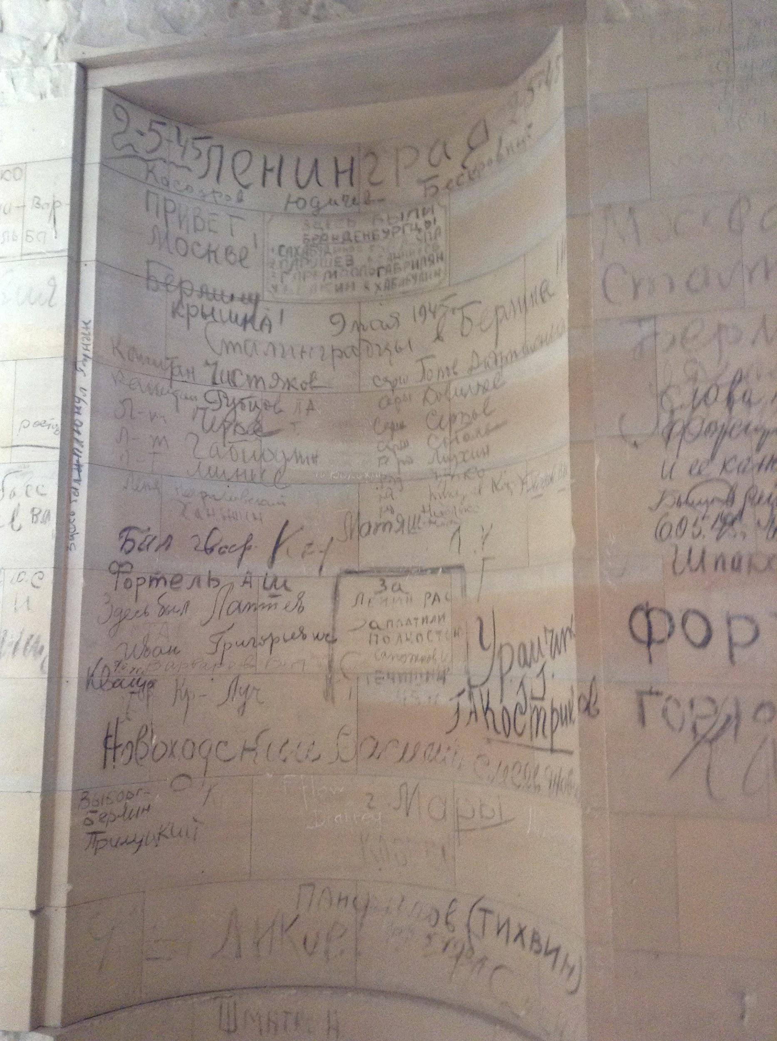
The Reichstag

Slide 34
