Slide 1
Big Era Five
Patterns of Interregional Unity
300 – 1500 C.E.

Slide 2
Patterns of Interregional Unity
Big Era Five lasted from 300 CE to 1500 CE.
Welcome to Big Era Five!
300 CE – 1500 CE
300 CE – 1500 CE
Big Era 3
Big Era 4
Big Era 5
Big Era 2
Big Era 3
Big Era 4
Big Era 5
Big Era 6
Big Era 2
10,000 BCE
1000 BCE
1800 CE
10,000 BCE
1000 BCE
1800 CE

Slide 3
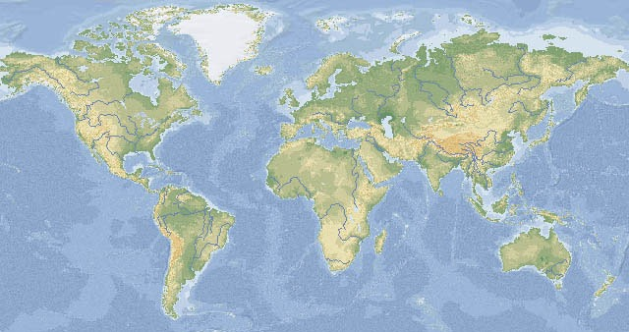
Microsoft®Encarta®Reference Library 2002. ©1993-2001 Microsoft Corporation. All rights reserved.
During Big Era Five, many connections were established among regions. These formed interregional patterns of unity.

Slide 4
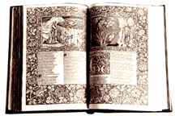
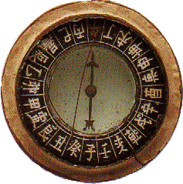
At the start of Big Era Five, numerous inventions, trade goods, ideas, and religions were starting to spread from their regions of origin.

Slide 5
…That spread of ideas and things is part of cultural exchange.
By the end of Big Era Five, many of these important ideas and useful things had spread all across Afroeurasia…
…

Slide 6
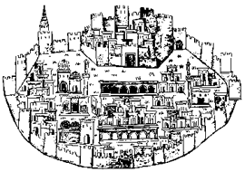
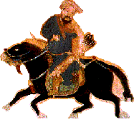
Cultural exchange had many aspects.
Population increased and people migrated.
Trade networks expanded and cities grew.
Huge empires brought many different groups of people together.
People shared ideas across regions.

Slide 7
Let’s take a closer look at each of these causes of cultural exchange.
Population
Trade
Ideas
Empires

Slide 8
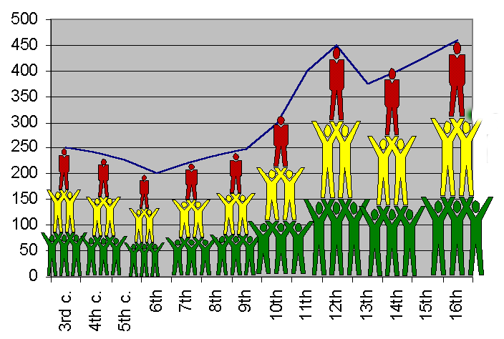
Population
World population grew from about 250 million to 460 million between
200 CE and 1500 CE.

Slide 9
Were there billions of people living on the earth then as there are now?
Population
No, then people were counted only in the millions.
A world population of 460 million in 1500 CE is about the same as the population of North America today!

Slide 10
Population
World Population
The population of the Americas was much smaller than the population of Afroeurasia.
American Population

Slide 11
As a result, cultural exchange in the Americas was less extensive than in Afroeurasia.
40 million equals the population of Spain or Colombia today!
Population
Less than 40 million people were spread over two huge continents.

Slide 12
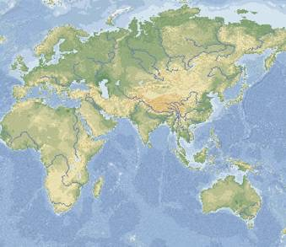
Afroeurasia
So, we’ll look at cultural exchange in Afroeurasia, and then return to the Americas later.
Population
Microsoft®Encarta®Reference Library 2002. ©1993-2001 Microsoft Corporation. All rights reserved.

Slide 13
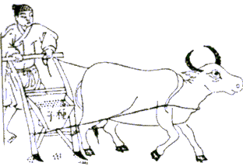
Population growth in Afroeurasia affected the environment.
Population
Deforestation happened when cities and farming expanded.

Slide 14
Human impact on the environment had serious effects!
Population
Wood was insufficient for heat, construction, and metal-working.
Soil eroded and degraded.
River flooding devastated villages, farmlands, and cities.
Famines meant people didn’t get enough to eat.

Slide 15
Population increases affected the environment. Sometimes, people got up and moved on to new lands.
Population
Large groups of people moved around, or migrated.

Slide 16
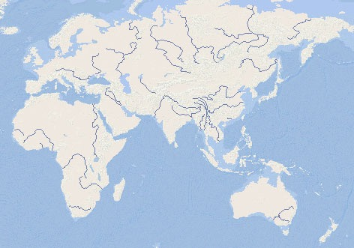
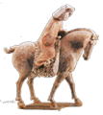
Vikings
Population
Germanic Tribes
Mongols
Turkic Groups
Chinese
Arabs
Bantu-Speaking People of Africa
People of Oceania
People migrated to new places in (and out) of Afroeurasia.

Slide 17
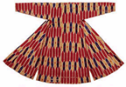
Population
Migrating groups moved into other groups’ territories, forcing them to go elsewhere.
Migrating groups introduced new plants and animals into their new homes.
Migrations diffused technologies for farming, warfare, and crafts.
Migrations diffused languages, styles of living, and arts.
Migrations encouraged more cultural exchanges across Afroeurasia.

Slide 18
During Big Era Five, many, many states and empires came… and went.
Empires
Building states and empires involved cultural exchanges in Afroeurasia.

Slide 19
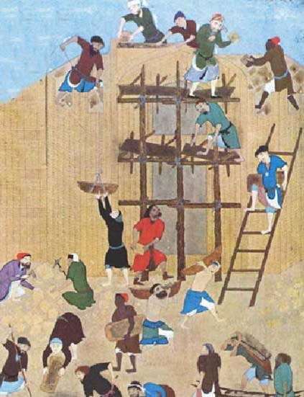
Empires
New ruling groups built on the foundations of earlier states and empires.

Slide 20
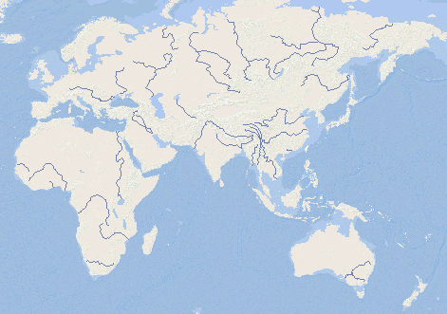
Frankish Kingdoms
Avar Kingdom
Parhae
Byzantine Empire
Sassanid Empire
Yamoto Japan
Sui China
Silla
Harsha’ Empire
Ghana
Chalukya
Axum
States and Empires in 600 CE

Slide 21
Carolingian
Cordoba Caliphate
Byzantine
Parhae
Gurjara-Pratihara
Tang China
Silla
Abbasid Caliphate
Heian Japan
Ghana
Axum
Srivijaya
States and Empires in 800 CE

Slide 22
Scandanavian Kingdoms
Russia
England
H.R.E.
Poland
France
Mongol Empire
Spain
Hungary
Portugal
Rum
Koryo
Almohad Caliphate
Sung China
Kamakura Japan
Ayyubid Caliphate
Delhi Sultanate
Mali
Ethiopia
Angkor
Oyo
Benin
Zimbabwe
States and Empires in 1237 CE

Slide 23
Union of Kalmar
Russian States
Scotland England
Holy Roman Empire
Poland-Lithuania
Khanate of the Golden Horde
Jagatai Khanate
France
Hungary
Portugal
Castile
Ottoman Emp.
Korea
Granada
Timurid Empire
Ming China
Ashikaga Japan
Marinids Hafsids
Mamluk Sultanate
Mali
Oyo Benin
Ethiopia
Vijayanagara
Siam
Zanj City-States
Majapahit
Zimbabwe
States and Empires in 1400 CE

Slide 24
Wars led to destruction but produced new inventions.
Strong governments protected trade routes and stabilized currencies.
Royal courts were patrons of science, religious institutions, and arts.
Large states brought together many ethnic, language, and religious groups.
Empires
How did states and empires stimulate cultural exchanges in Afroeurasia?

Slide 25
Trade
Trade was also closely linked to cultural exchange.
Empires supported trade in Afroeurasia. Merchants traveled great distances in search of wealth.

Slide 26
The number of cities grew, as well as trade networks between them.
Trade

Slide 27
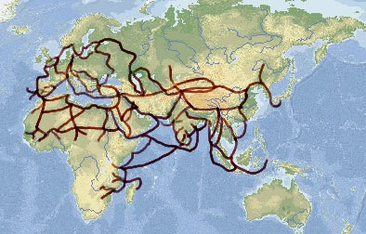
From 300-1500 CE, trade routes extended farther and were used by more travelers.
Trade
Microsoft®Encarta®Reference Library 2002. ©1993-2001 Microsoft Corporation. All rights reserved.

Slide 28
Trade helped spread religions, languages, ideas, and arts.
Trade stimulated use of natural resources.
Cities and manufacturing centers grew bigger.
Banks, credit, and money systems encouraged regional and long distance trade.
Trade
How did expanding trade networks bring about cultural exchanges in Afroeurasia?

Slide 29
Ideas
During Big Era Five, universal religions spread across Afroeurasia.
Universal religions are belief systems that anyone can join – they’re not limited to any one group.

Slide 30
The spread of universal religions from 300-1500 CE
Ideas
Buddhism
Christianity
Hinduism
Islam

Slide 31
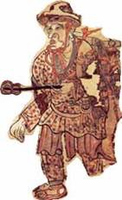
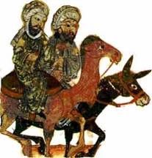
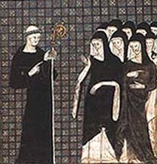
Who spread these universal
religions across Afroeurasia?
Ideas
Monks spread Buddhism.
Traders and Sufi orders spread Islam.
Missionaries
spread Christianity.

Slide 32
Universal faiths gave members a sense of community beyond political, class, or ethnic identities.
Religious scholars gathered and recorded knowledge and founded institutions of learning.
The spread of religions stimulated production and exchange of arts, literature, philosophy, and the sciences.
How did the spread of religion encourage cultural exchange in Afroeurasia?
Ideas

Slide 33
Ideas
What inventions, technologies, products, and ideas were exchanged across Afroeurasia?

Slide 34
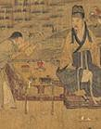
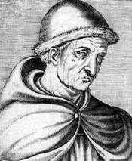
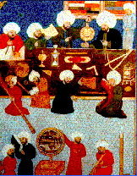
Scholars studied and spread knowledge in many institutions of learning.
Ideas
Sung scholar
Korean library
European astronomer
Muslim astronomers

Slide 35
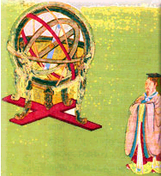
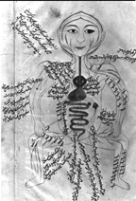
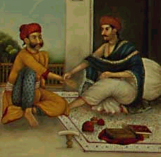
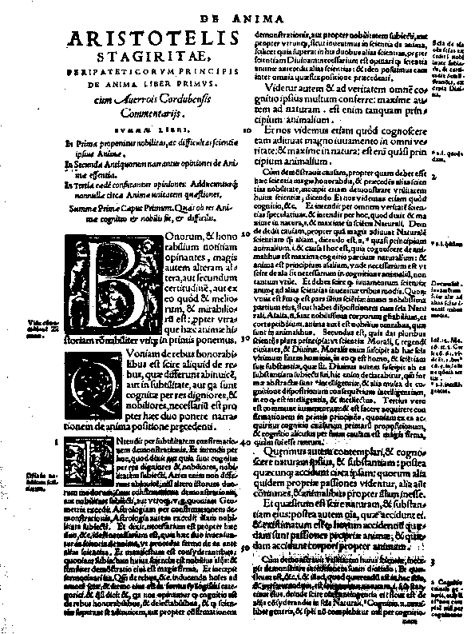
Natural sciences developed in
many places.
Ideas
Chinese
Muslim
Indian
European

Slide 36
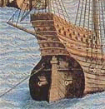
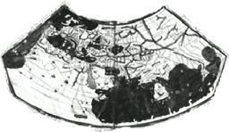
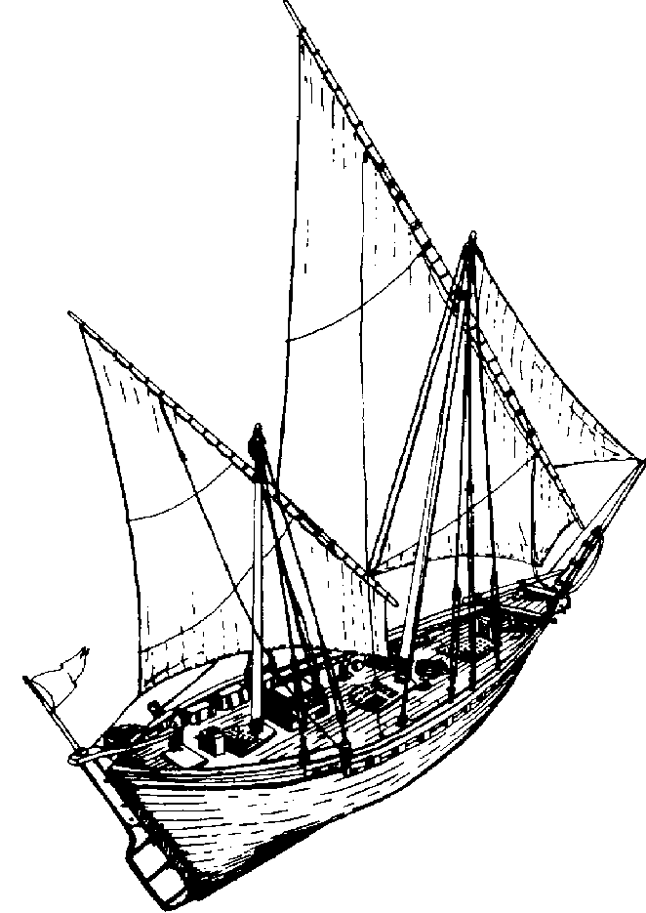
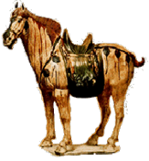
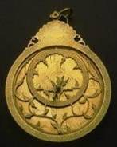
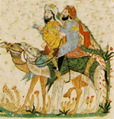
Transport and communication technologies improved.
Ideas
Stern-rudder
Books & paper
Mapmaking
Lateen sail
North Arabian camel saddle
Stirrup
Astrolabe

Slide 37
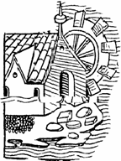
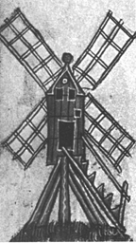
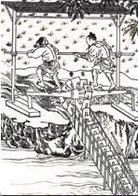
Water & energy technologies were transferred across Afroeurasia.
Ideas
Hydraulic systems carried water where expanding cities needed it.
Wheels lifted water to irrigate crops and drain swamps.
Waterwheels, windmills, and trip-hammers provided energy for pumping, grinding, milling, and pounding.

Slide 38
Crops also diffused across Afroeurasia. Travelers and migrants introduced plants into new regions. People began to grow, eat, and sell these crops.
Ideas

Slide 39
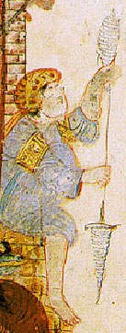
Sorghum fattened up folks when this cereal crop spread from eastern Africa to China.
Citrus fruits rolled from Southwest Asia to Spain, celebrated in garden and song.
Cane sugar sweetened a path from India to the Mediterranean.
Cotton wove its way from India to North Africa, Central Asia, and China.
Veggies like spinach, asparagus, and broccoli stirred vitamins into meals across the hemisphere.
Ideas

Slide 40
How did transfers of technology and products change people’s lives in Afroeurasia?
Ideas
The pace of innovation increased.
Knowledge accumulated more quickly.
Manufacturing and farming productivity increased.
People’s diets and health improved.
Sea travel and transport webs became thicker.

Slide 41
If you had to put the changes in Big Era Five into one sentence, what would it be?
You might say that by 1500 CE the world was connected, right?
But wait! You still haven’t said much
about the Americas!

Slide 42
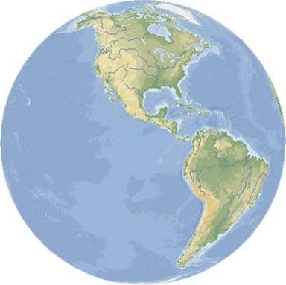
Well…the Americas and Afroeurasia were not yet permanently linked together.
…not until 1492 . . .
When Columbus set sail across the Atlantic . . .
Microsoft®Encarta®Reference Library 2002. ©1993-2001 Microsoft Corporation. All rights reserved.

Slide 43
The Americas had fewer people than Afroeurasia, and the two land masses were geographically isolated from each other. Developments in the two regions were similar in some ways and different in others. In any case, the Americas were also a region of active human interchange.
Microsoft®Encarta®Reference Library 2002. ©1993-2001 Microsoft Corporation. All rights reserved.

Slide 44
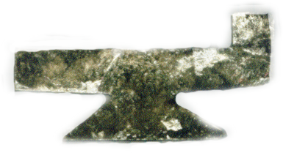
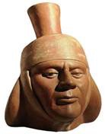
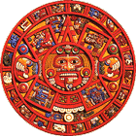
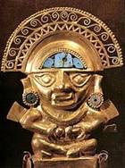
Cultural development and exchange in the Americas: The Maya, Inca, and Aztec Empires
Sciences like astronomy, mathematics and engineering were developed.
Trade routes connected regions.
Mining, irrigation, and agricultural technologies developed.
Crops like potatoes, maize, tomatoes, cotton, and chocolate were grown.
Mississippian Mica
Moche Ceramic
Mayan Calendar
Inca Gold
Corn & Potatoes

Slide 45
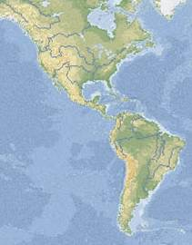
States and Empires in the Americas in 1500 CE
Mayan States
Aztec Empire
Inca Empire
Microsoft®Encarta®Reference Library 2002. ©1993-2001 Microsoft Corporation. All rights reserved.

Slide 46
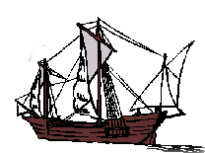
At the very end of Big Era Five, European mariners set out on trans-oceanic voyages to the Americas.
Those voyages linked the Americas with Afroeurasia for the first time since the migrations of people over 13,000 years earlier!
It had to happen sooner or later!

Slide 47
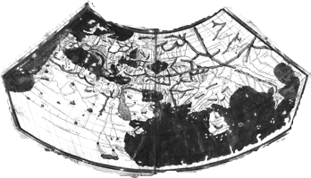
Cultural exchange in Afroeurasia before 1500 CE made possible the technologies that in turn permitted transoceanic voyages.
Mapmaking
Stern-rudder
Lateen Sail
Compass
Is that why people from Afroeurasia discovered the Americas, and not the opposite?

Slide 48
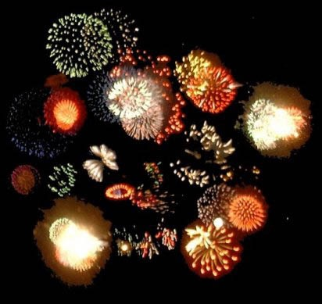
In Big Era Six, we’ll see learn about the explosive things that happened when migration, empires, trade, and ideas started moving around the entire globe.
End of Big Era Five
http://www.lvna.net/Activities/Fireworks/fireworks.html

