Slide 1
The First Crusade

Slide 2
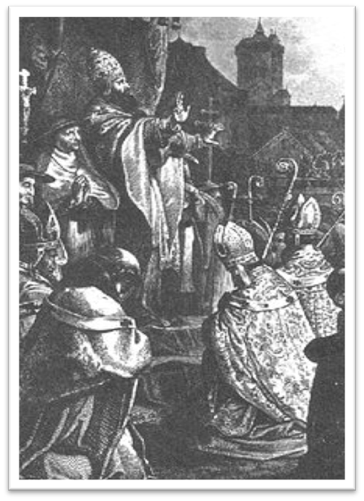
Pope Urban II
In 1095, Byzantine Emperor Alexios I contacted Pope Urban II about the threat of Turkish armies against Constantinople and the Fatamid Muslim’s control of Jerusalem
In November 1096, Pope Urban II considered Alexios’ plea at the Council of Claremont, and called for a crusade against the Muslim Turks.
Pope Urban II at Claremont

Slide 3
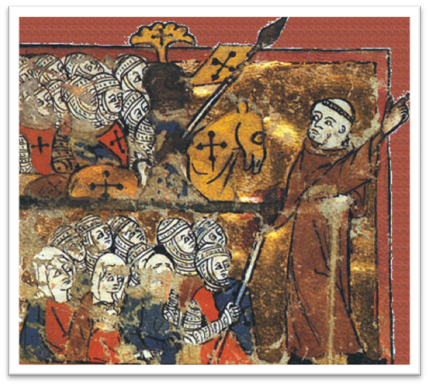
Crusaders
Ten of thousands of peasants, nobles, and clergy responded to Urban II’s call.
In the spring and summer of 1096, armies of Crusaders departed from Western Europe for Constantinople.
Peter the Hermit Leading an army of crusaders

Slide 4
Shi’ite Fatamids
Prior to the Crusades, there was infighting between Sunni Seljuk Turks, who had conquered a lot of land and the Shi’ite Fatamid Caliphate.
Just before the First Crusade, the Fatamids captured Jerusalem from the Seljuk Turks.
Knowing the Crusaders were coming, the Fatamids expelled all Christians from Jerusalem.

Slide 5
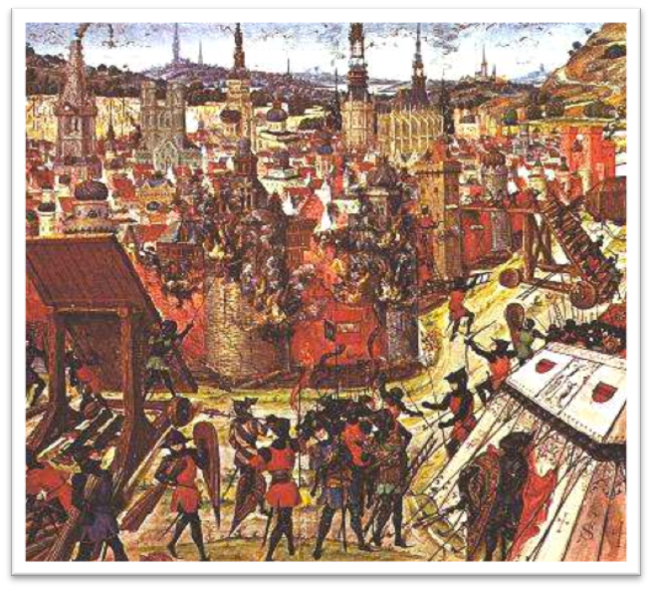
Capture of Jerusalem
Between 1096 and 1099, Crusader armies made their way to Jerusalem, engaging in several major battles with Turkish forces.
On July 17, 1099, Crusaders took the city of Jerusalem, after a long and costly siege. Some historians estimate the number of casualties at 100,000.
Capture of Jerusalem

Slide 6
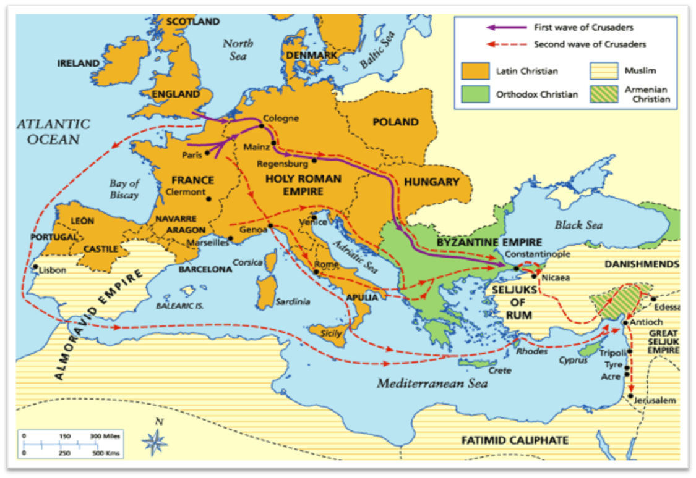
Map of the First Crusade

Slide 7
Perspectives
Christians believed they were fighting the Crusades in the name of Jesus to take back the place of his birth from infidels.
Muslims believed they were defending land that was theirs. From their perspective, Christians were brutal invaders.

Slide 8
Central Historic Question
What happened when Crusaders entered Jerusalem during the First Crusade?

Slide 9
Document C
This document is from the French chaplain Fulcher of Chartres, a Christian, who participated in and wrote first-hand accounts of the First Crusade. In this excerpt, written sometime between 1100 and his death in 1127, he describes the Crusaders taking Jerusalem.

